Slide 1
Organizing a Systematic
Social Media Presence:
A Team Approach
Stacey Horath, MBA, Exec. Asst. to the Interim Dean of University Libraries, Stony Brook University,
Chair of Communications & Outreach Working Group (COWG) &
Member of Social Media subgroup
Laurel Scheinfeld, MLIS, Health Sciences Librarian, Stony Brook University
Member of Communications & Outreach Working Group (COWG) & Member of Social Media subgroup

Slide 2
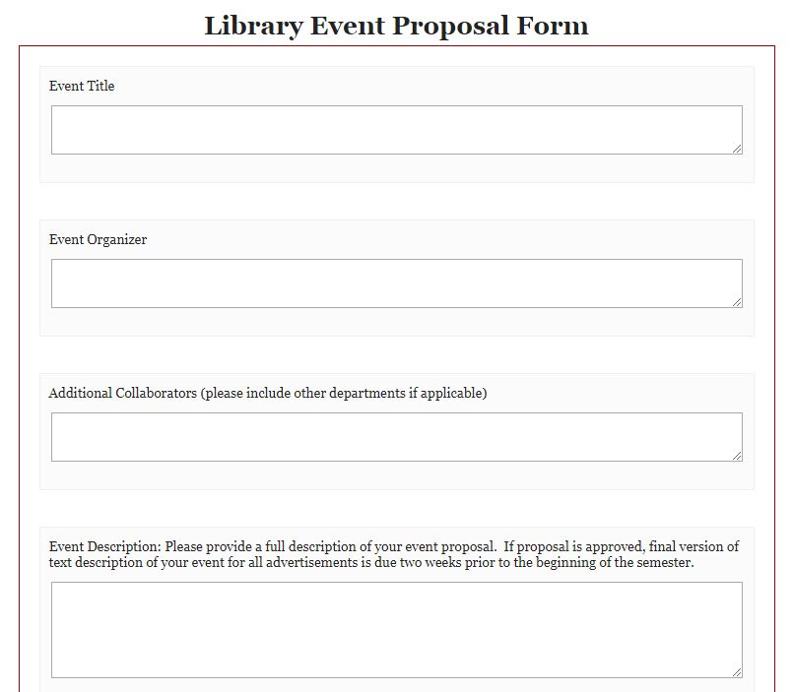
PROMOTING EVENTS
SBU Libraries has over 70 events per year
Revised event submission & approval procedures
Notes:
Revised event submission & approval procedures - designed new format for collecting event proposals; Google form to Qualtrics; better measurement tools

Slide 3
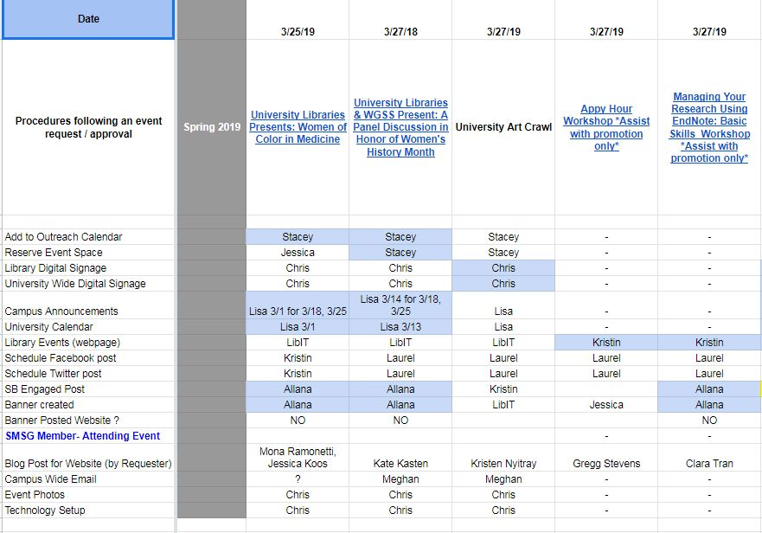
Created a shared workflow for publicizing events
Notes:
Created a shared workflow for publicizing events - created hyperlinks to events page; all forms of promotion are included in one place; all members have access and can view their assigned tasks; tasks are highlight when completed

Slide 4




Notes:
Examples of event and workshop banners used on social media; you will notice different sizes which we will discuss later in this presentation

Slide 5
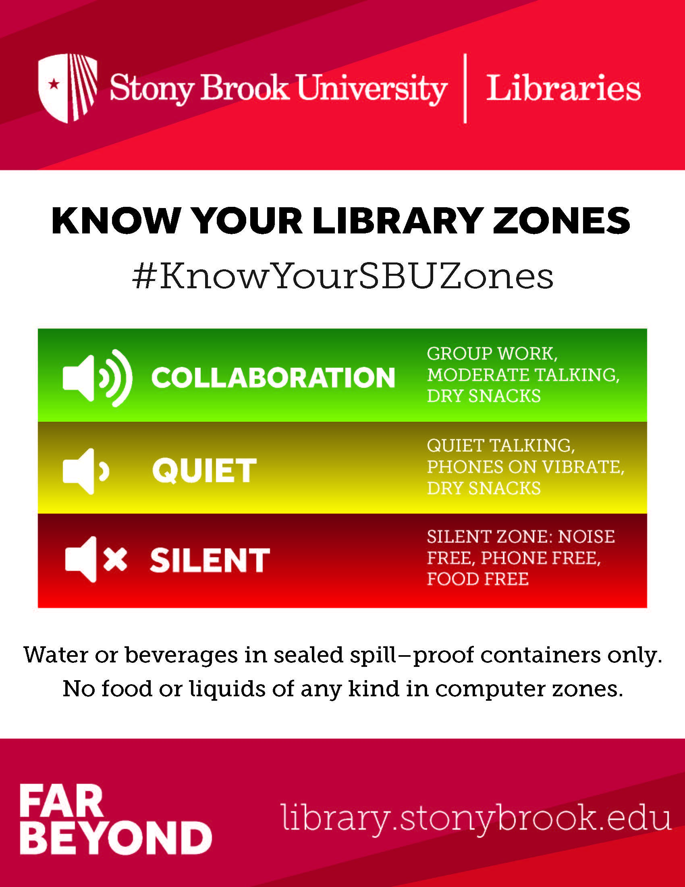
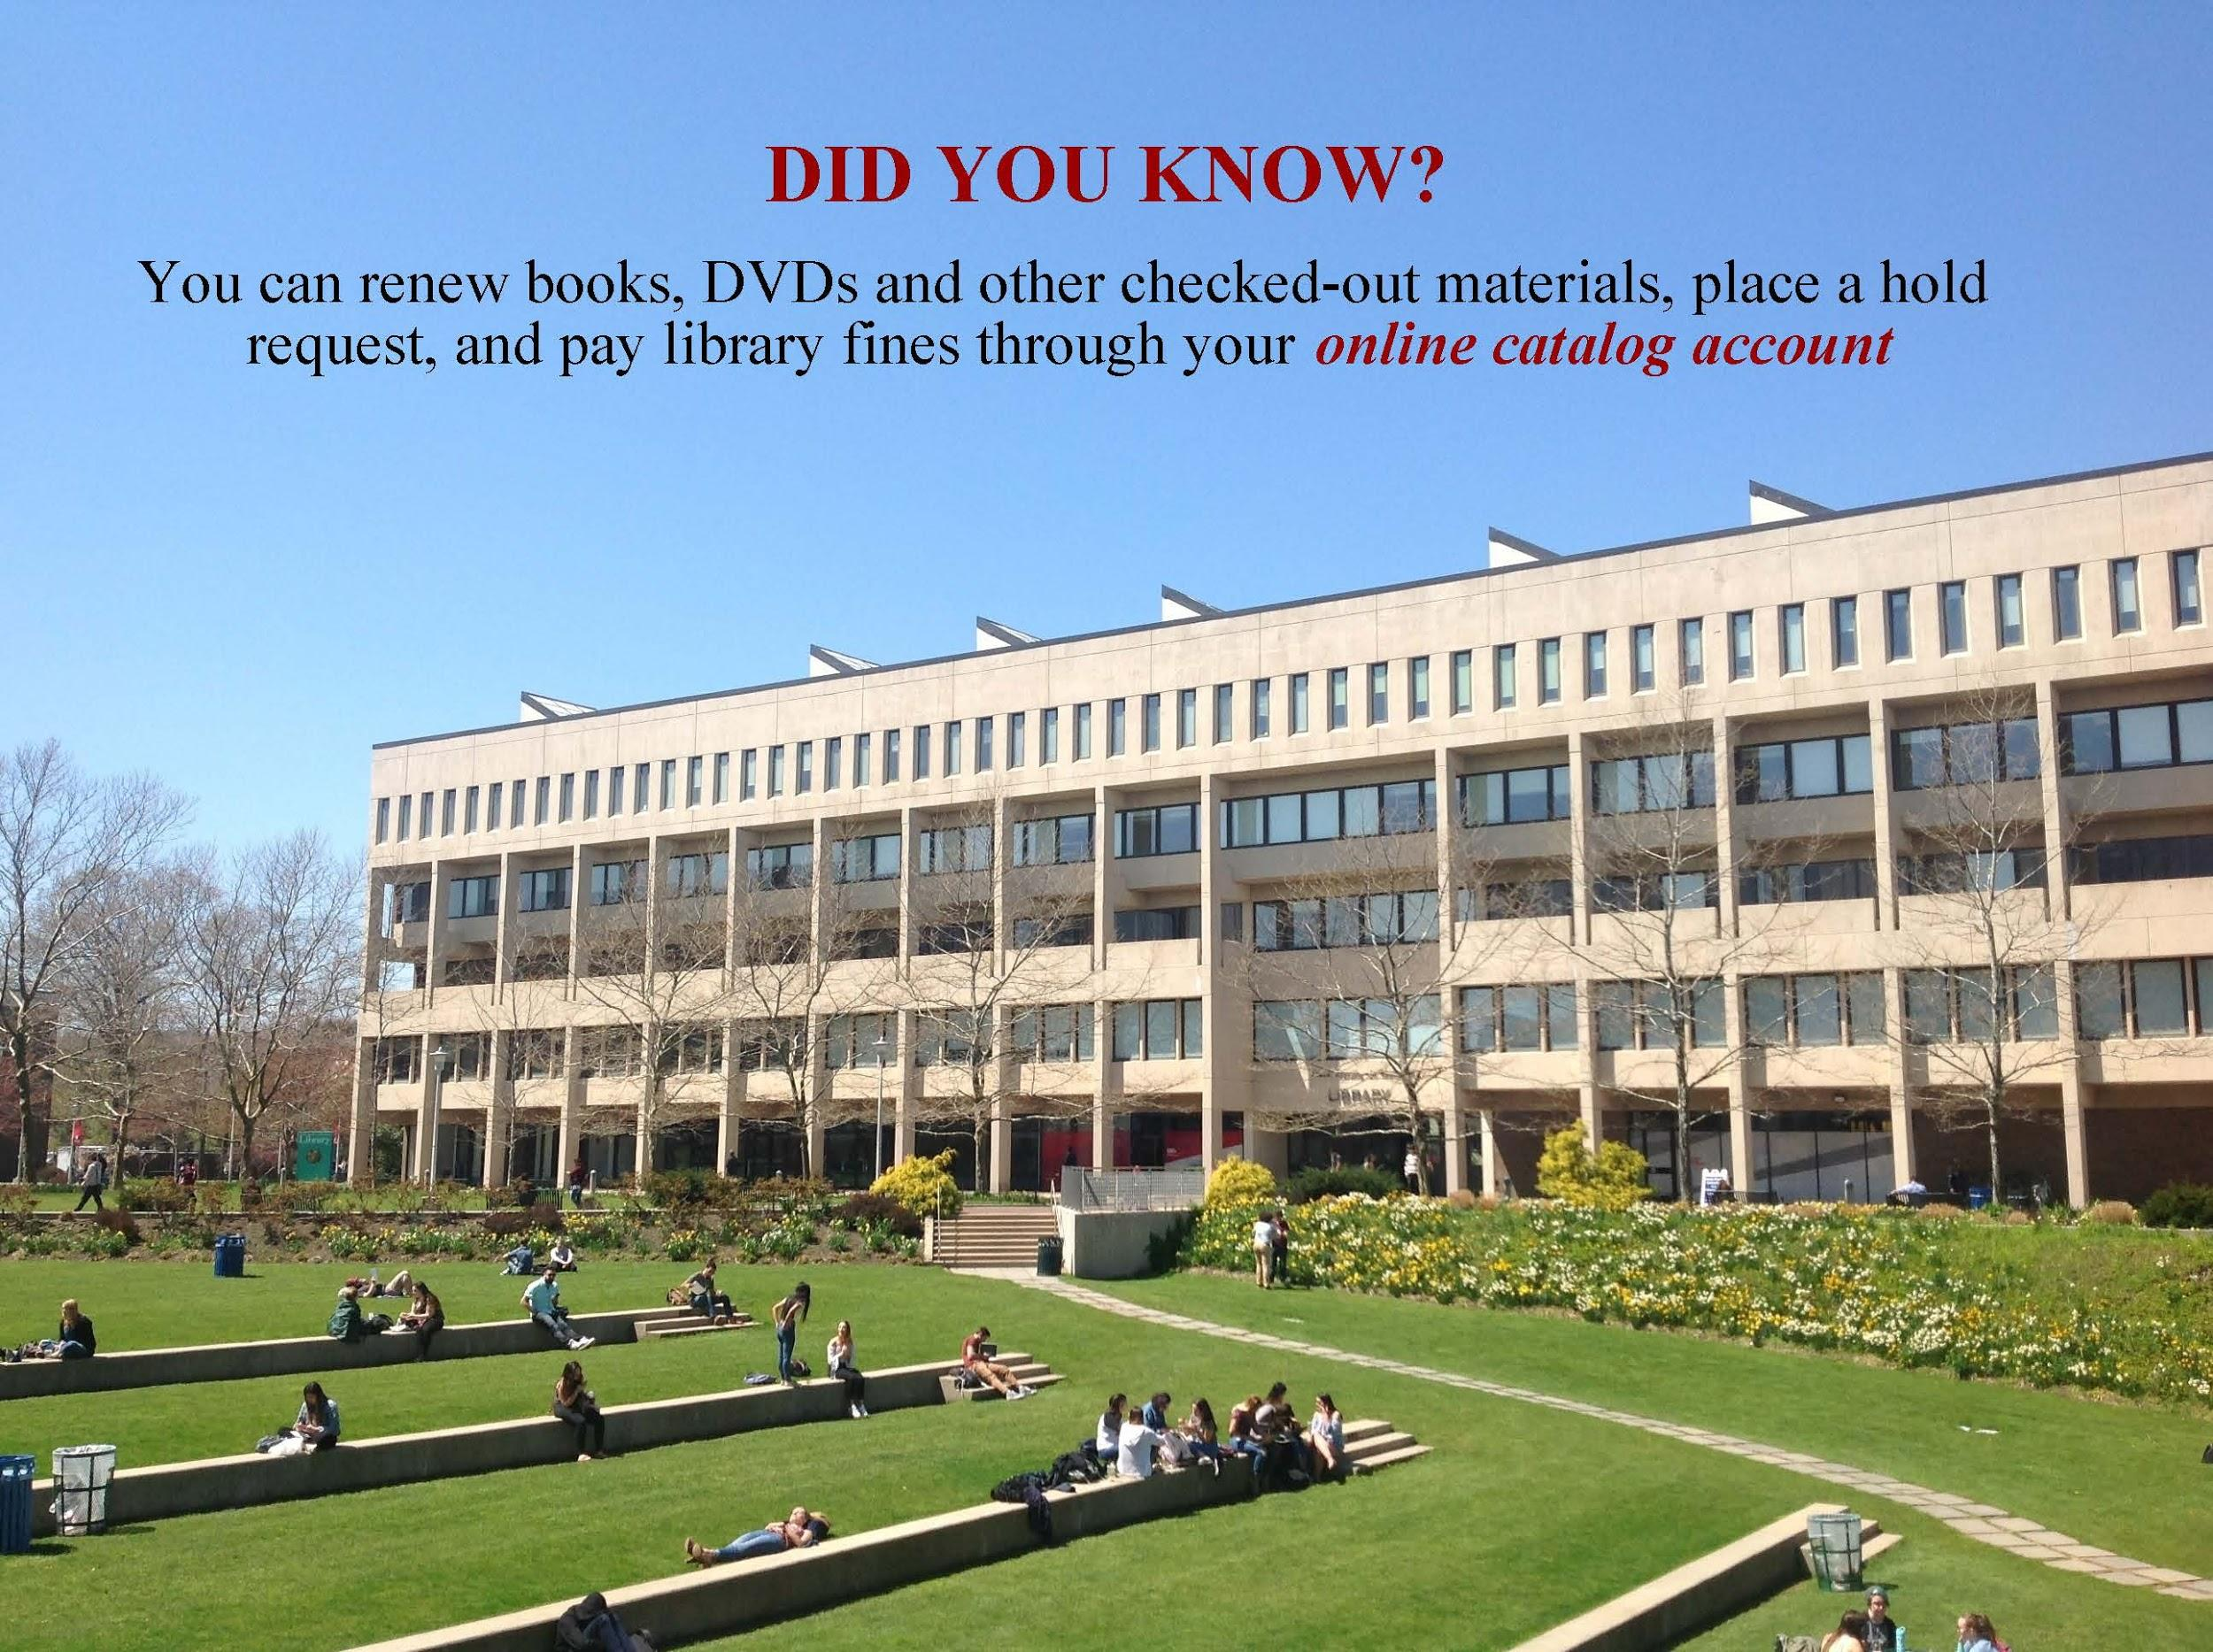

Assigned staff are responsible daily for posting campaigns, promoting events & workshops, & ‘engaging’
on social media through likes, re-tweets, & shares
Notes:
Examples of 3 of our social media campaigns that are meant to promote library policies and resources/services

Slide 6


STATISTICS
Twitter Impressions
 | 2016 - 2017 | 2017 - 2018 | 2018 - 2019
October | 10,600 | 33,100 | 28,500
February | 7,554 | 38,100 | 34,600
Facebook Likes
 | 2016 - 2017 | 2017 - 2018 | 2018 - 2019
October | 938 | 1,036 | 1,074
February | 955 | 1,047 | 1,090

Slide 7
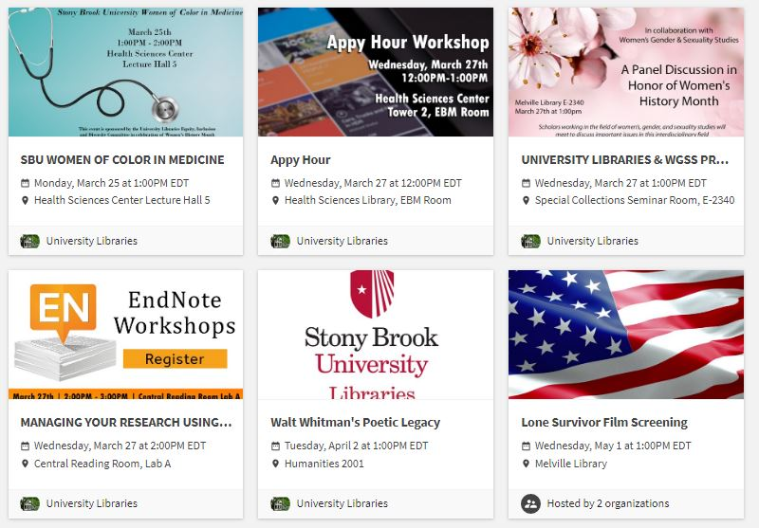
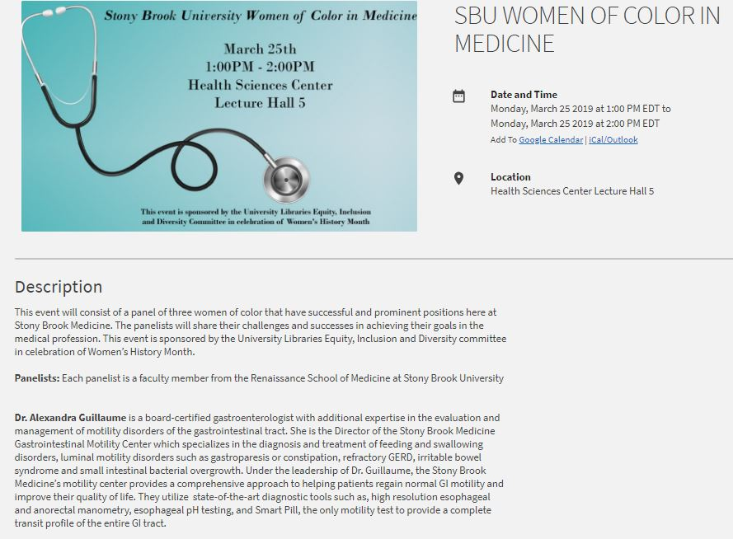
INCREASING ENGAGEMENT
SB Engaged
Online platform for all student clubs, organizations & campus departments to discover & utilize discussion, news posts, & group messaging
Notes:
SB Engaged shows a listing of all library events/workshops for the semester; clicking on an event will allow you to view a full description of the event details; popular way to promote to students; platform is specific to SBU

Slide 8
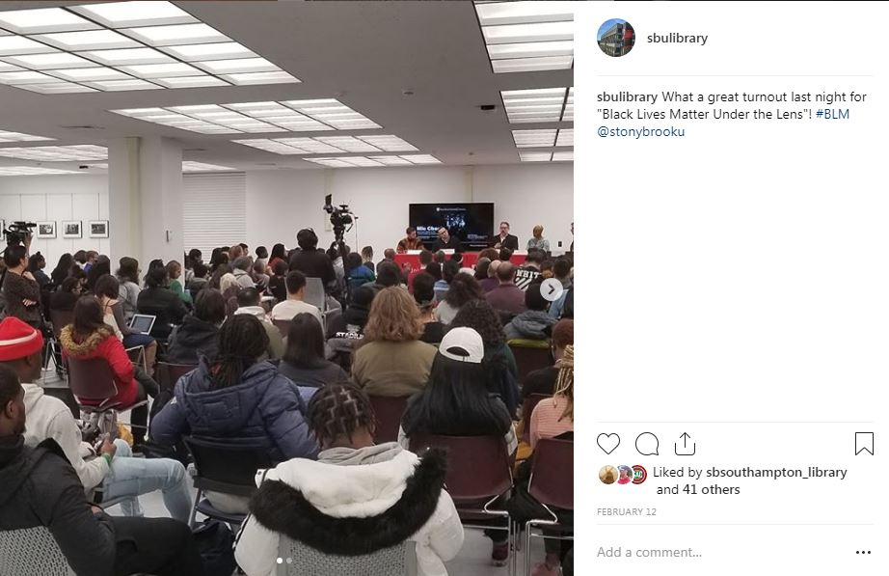
INCREASING ENGAGEMENT
Instagram
Popular among students
Engagement through video
In-the-moment photo ops
Reaching more followers
Effective Strategies
Utilize student staff in creating graphics
Re-focus campaigns each semester
Peer-to-peer promotion
Organization system for digital banners
Notes:
Instagram
Popular among students - we have learned through our Marketing and Communications department that most SBU students are on instagram
Engagement through video - effective way to promote library events/workshops, resources/services
In-the-moment photo ops - affords us the ability to showcase our events as they are happening; committee members assigned to a campaign receive an iPad
Increased followers - we have seen an increase in the number of followers since beginning to post regularly to Instagram
Effective Strategies
Utilize student staff in creating graphics - match students ability with designing banners; Photoshop experience
Re-focus campaigns each semester - assess which campaigns are most effective and change as needed
Peer-to-peer promotion - events/workshops receive more promotion when library student staff are involved
Organization system for digital banners - all completed banners are stored in a Google drive that is shared with all members of the committee

Slide 9
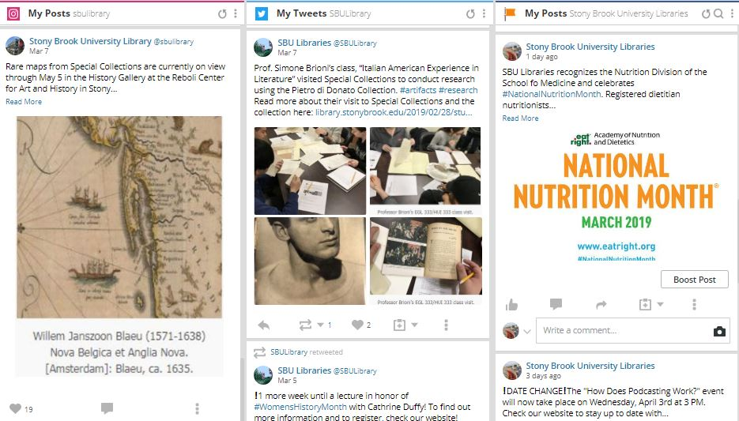
CHALLENGES
Managing member roles
Maintain consistent branding
Scheduling posts
Incorporating current hashtags & handles
Required formats & sizes for graphics
Notes:
Speak about what challenges we have faced and are still working on improving and show what we have done to help our workflow become more efficient.
Managing member roles - as we take on new committee members, we attempt to equally divide the workload; streamline the workflow process and adjust with the needs of our students; provide proper technology to members to capture library moments
Maintain consistent branding - we have many people involved in the promotion of library activities and finding ways to ensure we are all promoting with the same University branding and continuity across all library hosted activities
Scheduling posts - looking for ways to help lessen the workload on committee members but still be able to successfully promote library activities - Hootsuite is one of those tools we utilize on a daily basis
Incorporating current hashtags & handles - creating a database that has all current hashtags/handles for campus orgs and departments is a challenge but has been very helpful when looking to quickly locate the proper tags - student staff are heavily used to keep the database as up to date as possible
Required formats & sizes for graphics - creating multiple sizes of the same banner for each platform we use is a challenge and student staff are crucial to assisting with keeping files current

Slide 10
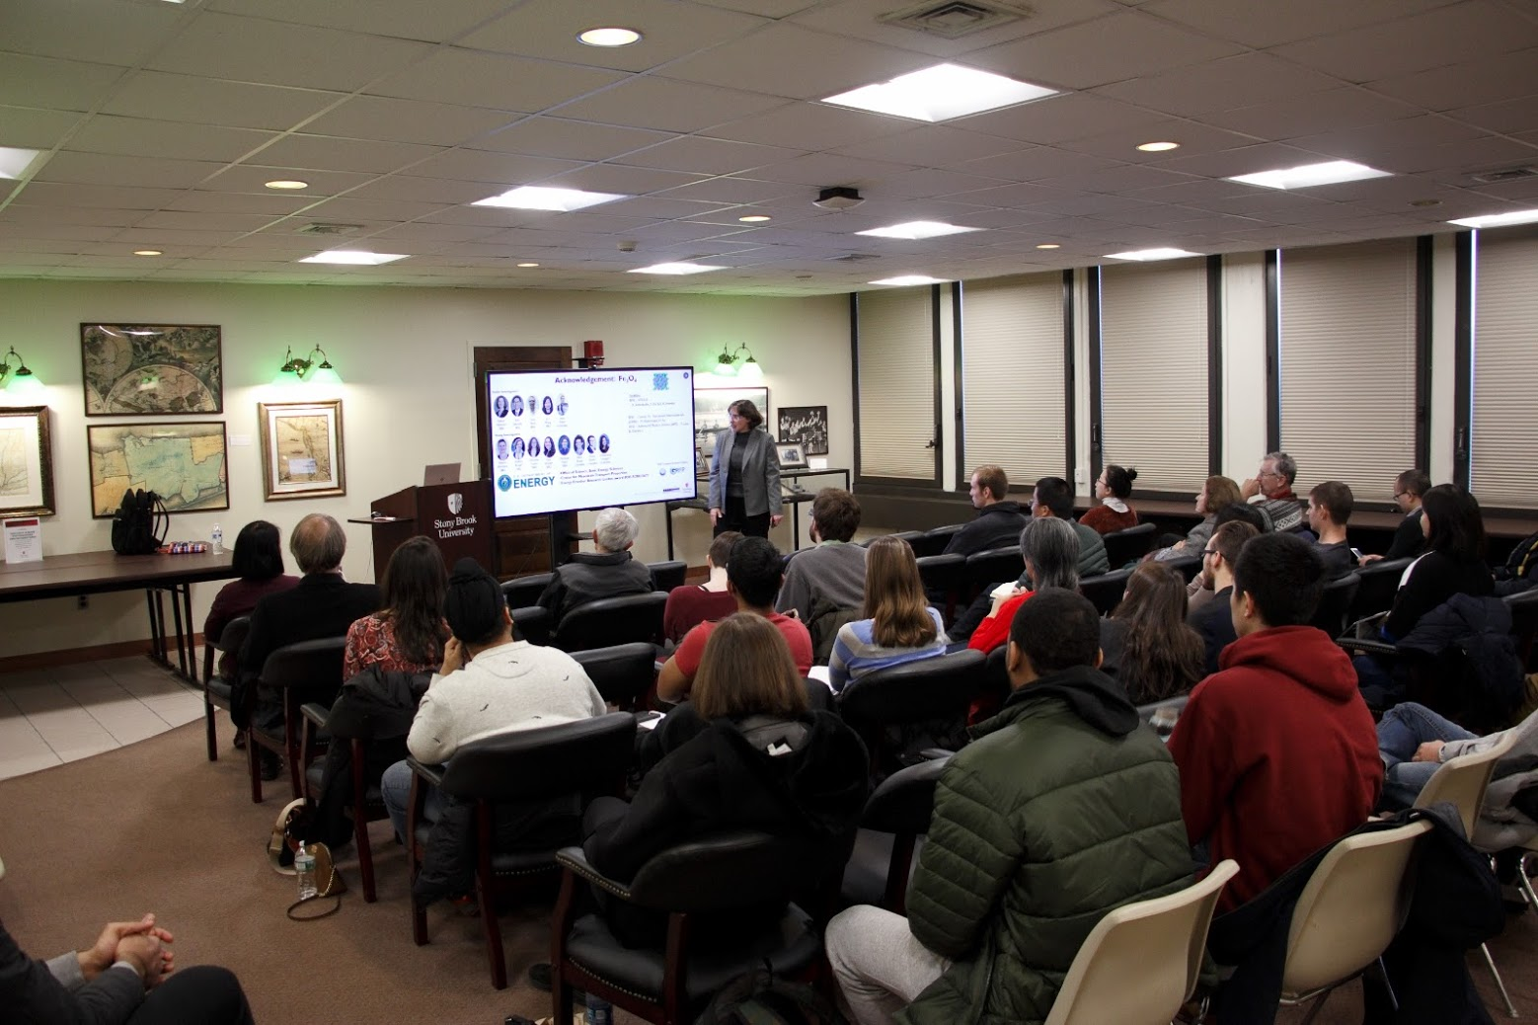
MOVING FORWARD
Assessment
Collecting data
Population of attendees (i.e. student, faculty or staff)
Satisfaction survey
Involvement
Learning from our colleagues & peer institutions
Increased student involvement in the creation, planning & participation in library events
Notes:
Assessment
Collecting data - learning more about our demographics and determining what types of activities and resources they are looking for
Population of attendees (i.e. student, faculty or staff) - finding out WHO is attending which of our events so gain a better understanding of what interests them
Satisfaction survey - finding ways to tweak and improve on library events and services; seek to hone in on what draws our patrons to our branches
Involvement
Learning from our colleagues & peer institutions - attending more social media related conferences and seminars to glean from other institutions that are working through the same challenges we are faced with
Increased student involvement in the creation, planning & participation in library events - self-explanatory...

Slide 11
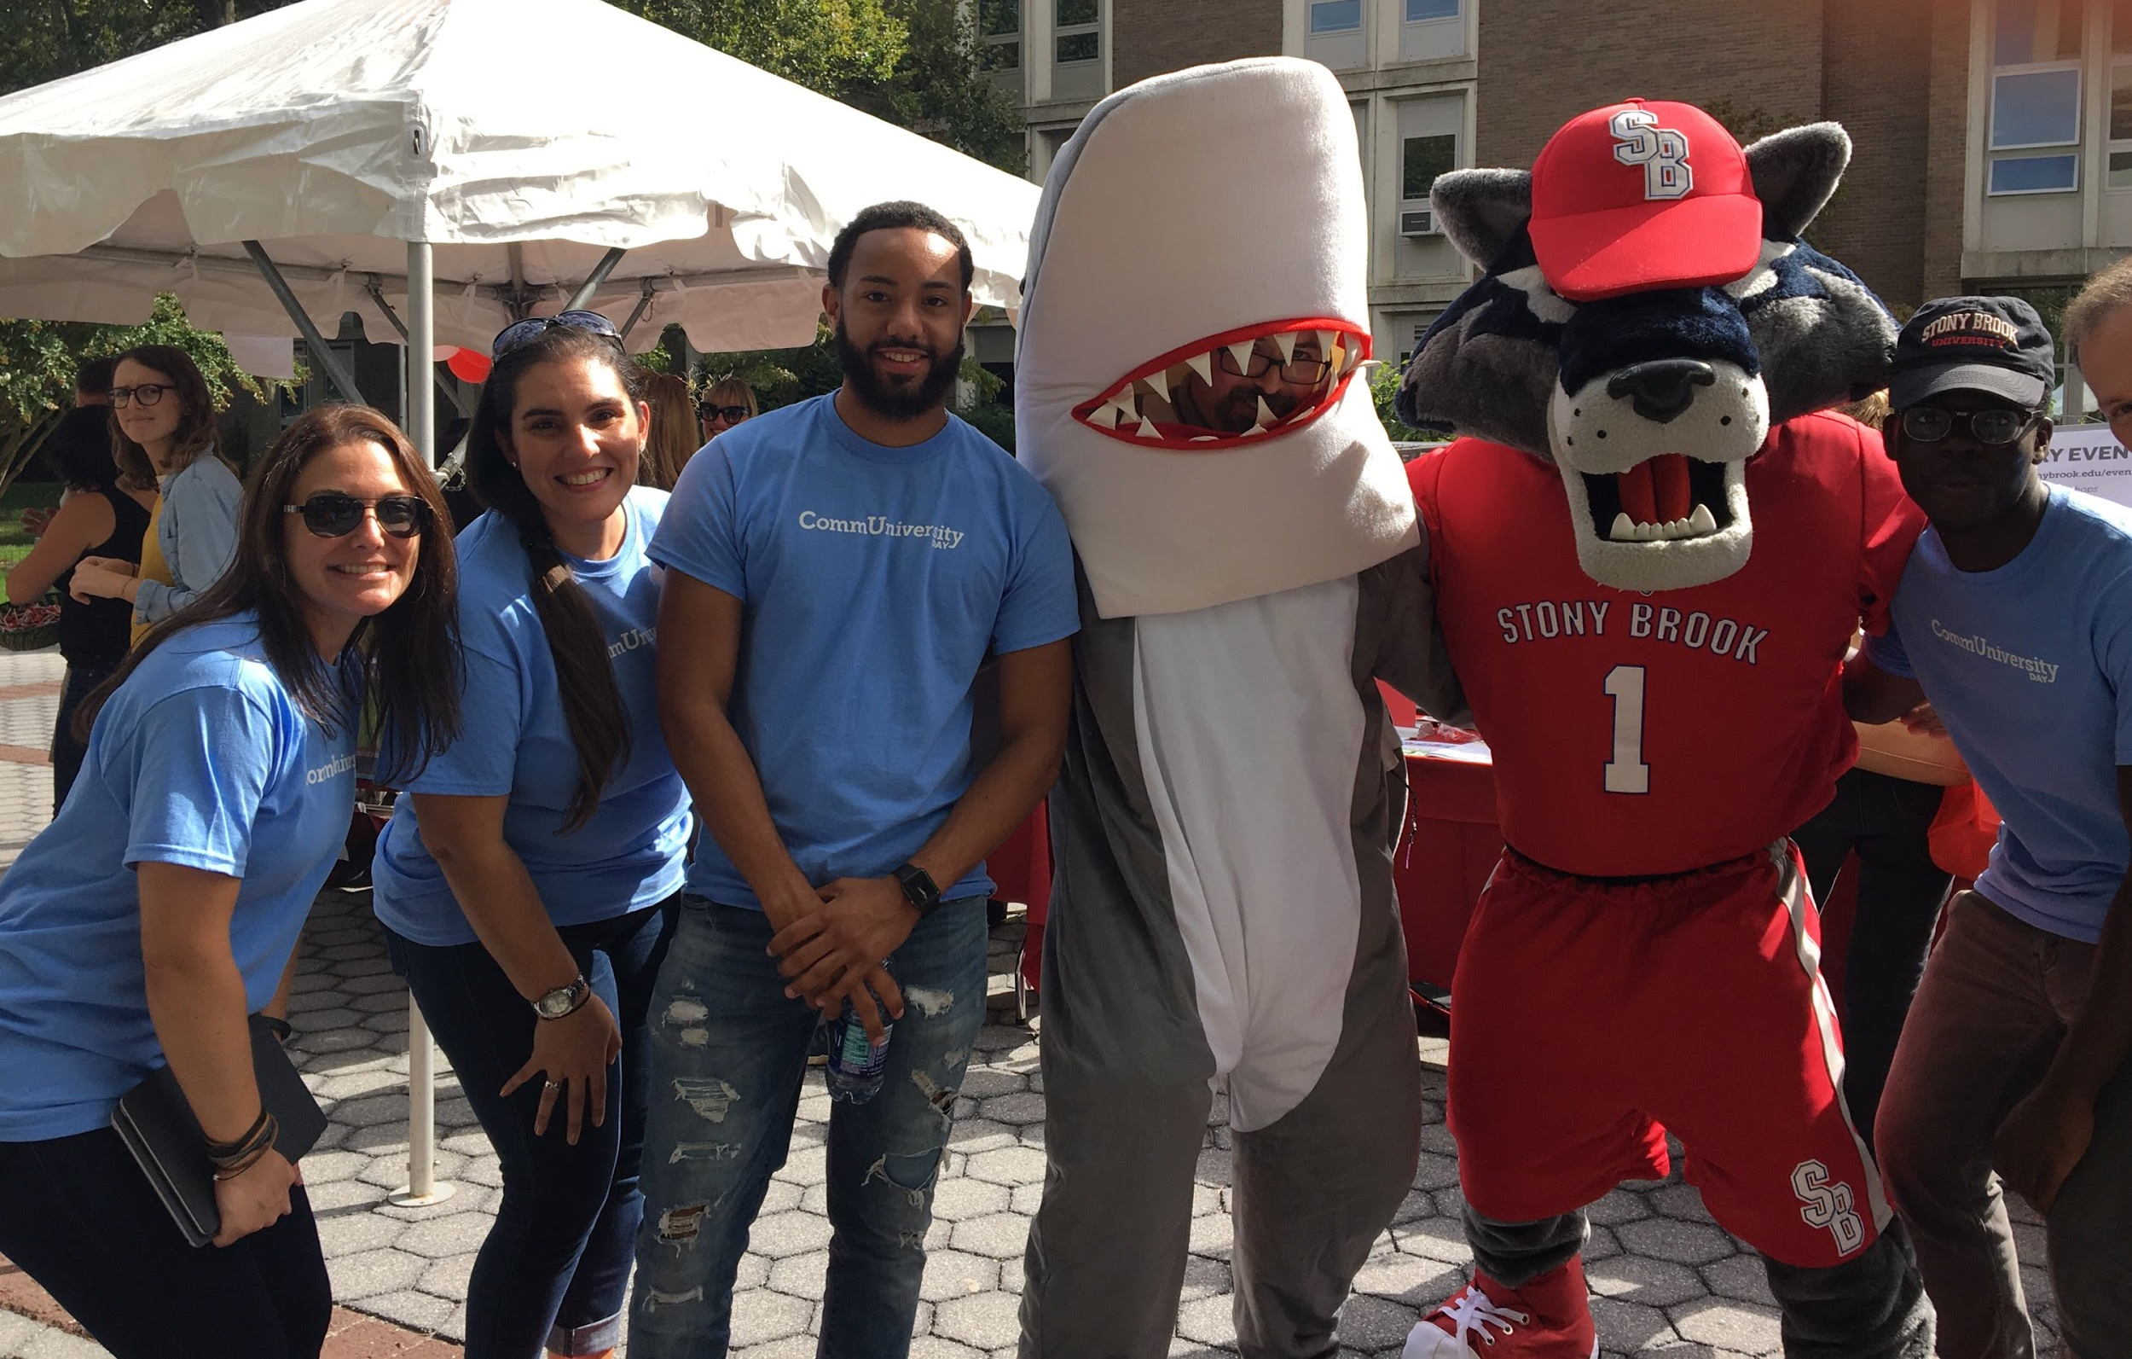
THANK YOU

