Slide 1

Designing Engaging Outreach for Online Students Using
Web-Based Tools
ACRL LMAO Group Meet-Up Fall 2019
Maria Deptula & Jessica Kiebler
Berkeley College

Slide 2


All library activities (resources, programs) have to include ONL community
BERKELEY COLLEGE ONLINE
First opened in 1998 – one of the first online programs
Students from 30 states (military personnel/veterans)
2019-2020 - 1,014 students - 25% of college population
54% of all students take at least one ONL class
Rated "Best Online Programs" in the past six years
Asynchronous instruction

Slide 3






Challenges:
Outreach to Online Students
Location
Time zones
Visibility
Language barriers
Communication methods - older vs. younger generations

Slide 4

AREAS FOR ENGAGEMENT
MAKE THEM FEEL THAT THEY BELONG
LET THEM SHOW WHO THEY ARE
This Photo by Unknown author is licensed under CC BY-NC-ND.

Slide 5

The Power of
LibGuides:
Information & Collaborations​

Slide 6
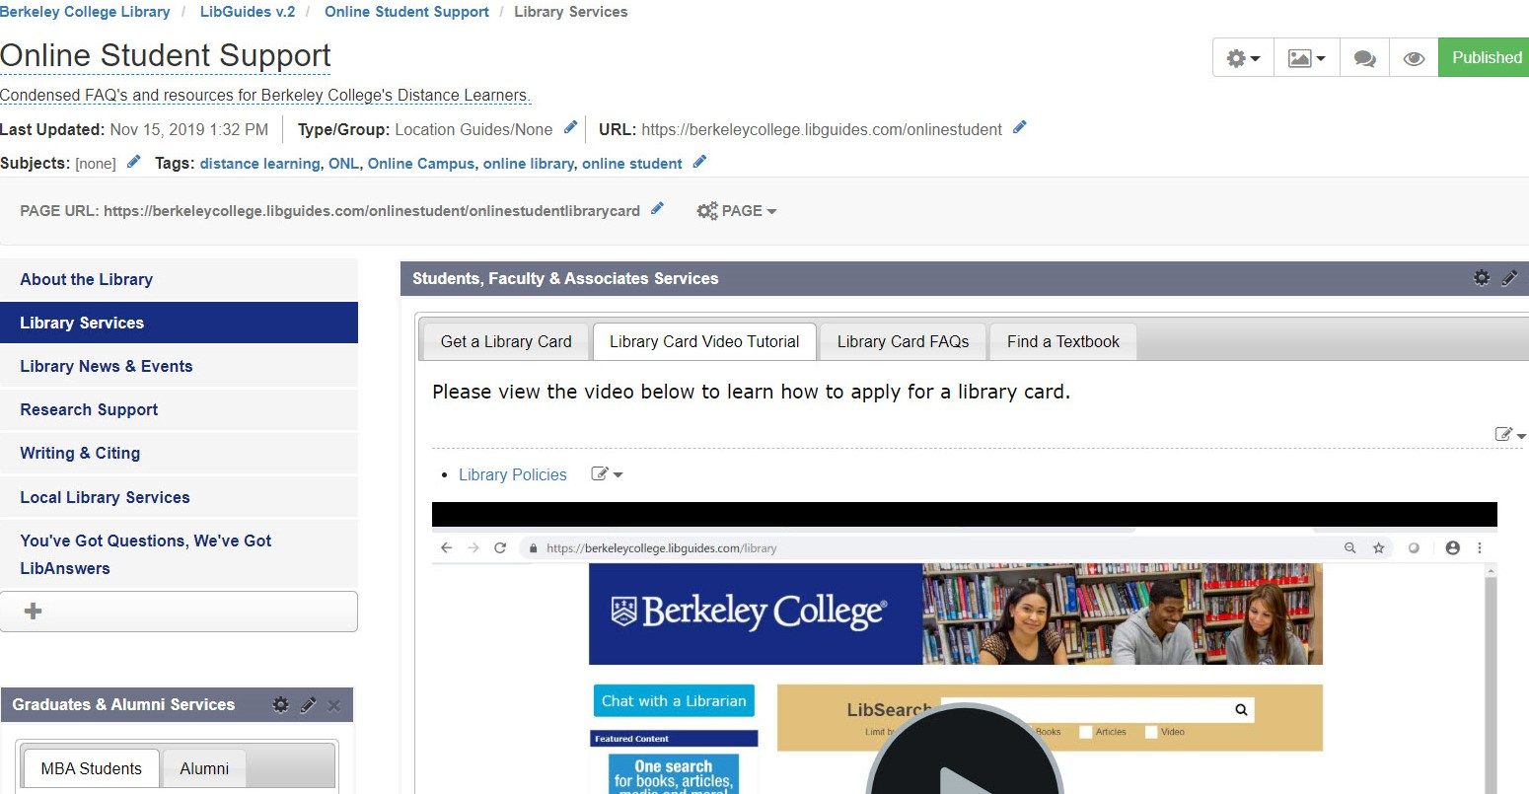
ONL Student Support
ONL Student Community
ONL Book Club
ONL Essay Contest
ONLINE STUDENT SUPPORT
ONL Specific Libguides ​

Slide 7
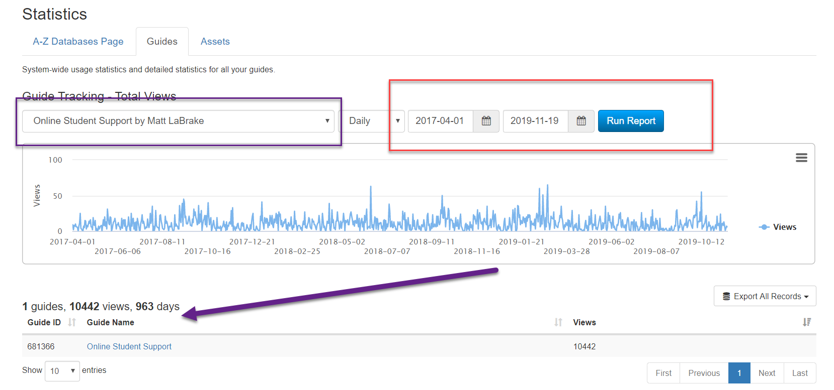
Usage Data

Slide 8
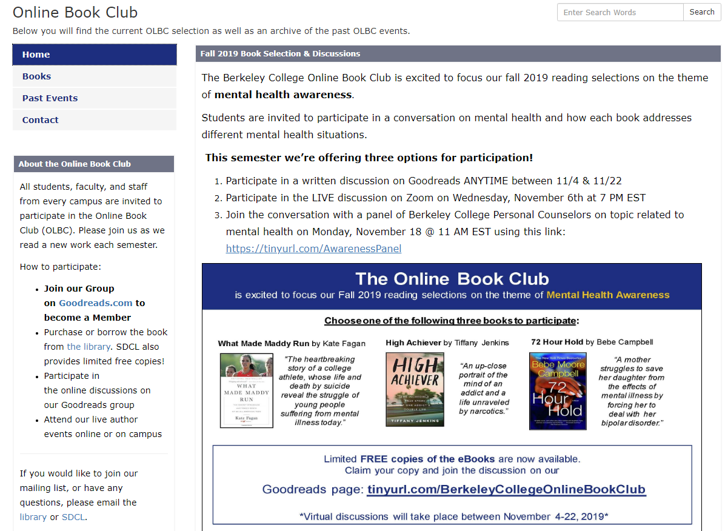
ONLINE BOOK CLUB ​
Started in 2015
Open to all students and associates
Database with over 500 names
Associated events - - authors' presentations, panels
Live & virtual audience
System-wide promotional emails
Collaboration of ONL Library and SDCL - support from all campuses
Notes:
- LibGuide presents information on current and past events
- Links out to Goodreads platform where interactions take place
- Free books are offered to students who agree to actively participate
- Some events include a streamed author presentation; this semester is a panel of Berkeley faculty/staff on mental health

Slide 9
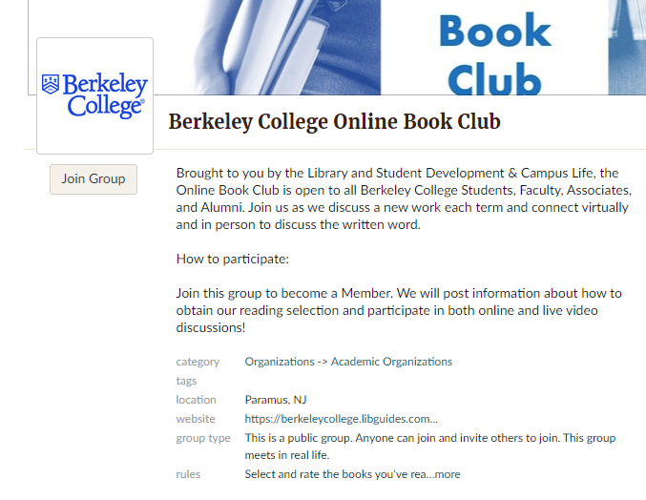
Goodreads Discussions​
Book(s) are selected an announcement posted to Goodreads
Student request/receive the book after their initial post
Discussion questions posted
Student participate in the discussion board
Notes:
- Since there are limitations to LibGuides, a web platform like Goodreads allows online students to connect

Slide 10
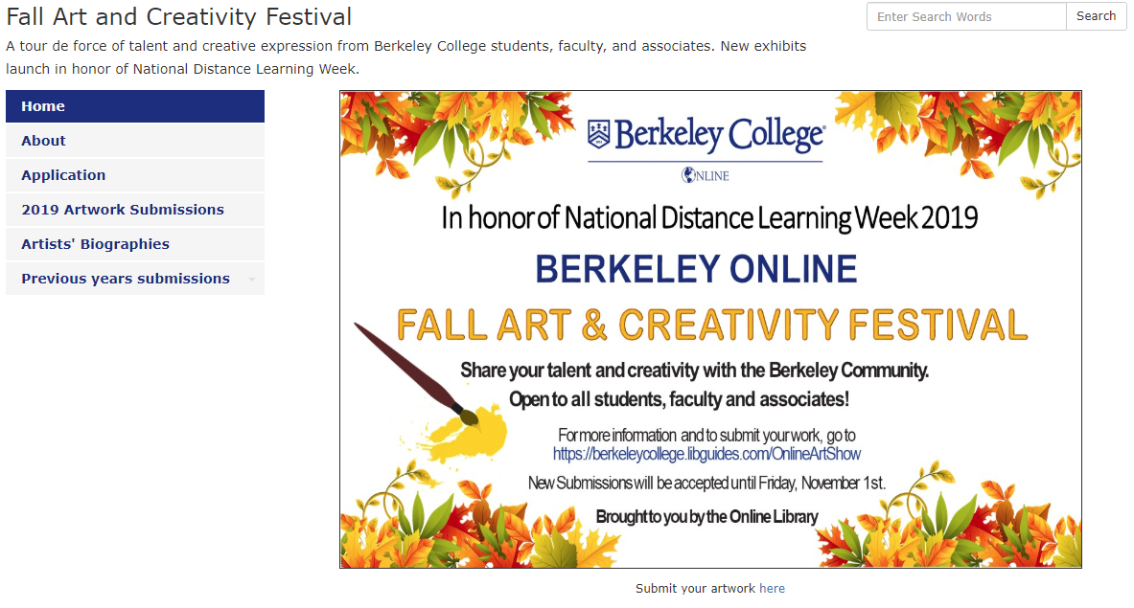
Submission Form
Terms of agreement
Various categories including specific for the majors
Descriptions of artwork submitted and bios
NATIONAL DISTANCE LEARNING WEEK
ART & CREATIVITY FESTIVAL​
Notes:
- Using a LibGuide as a way to re-create an art gallery
- Using forms to collect art and information
- LibGuide can also house past exhibitions

Slide 11
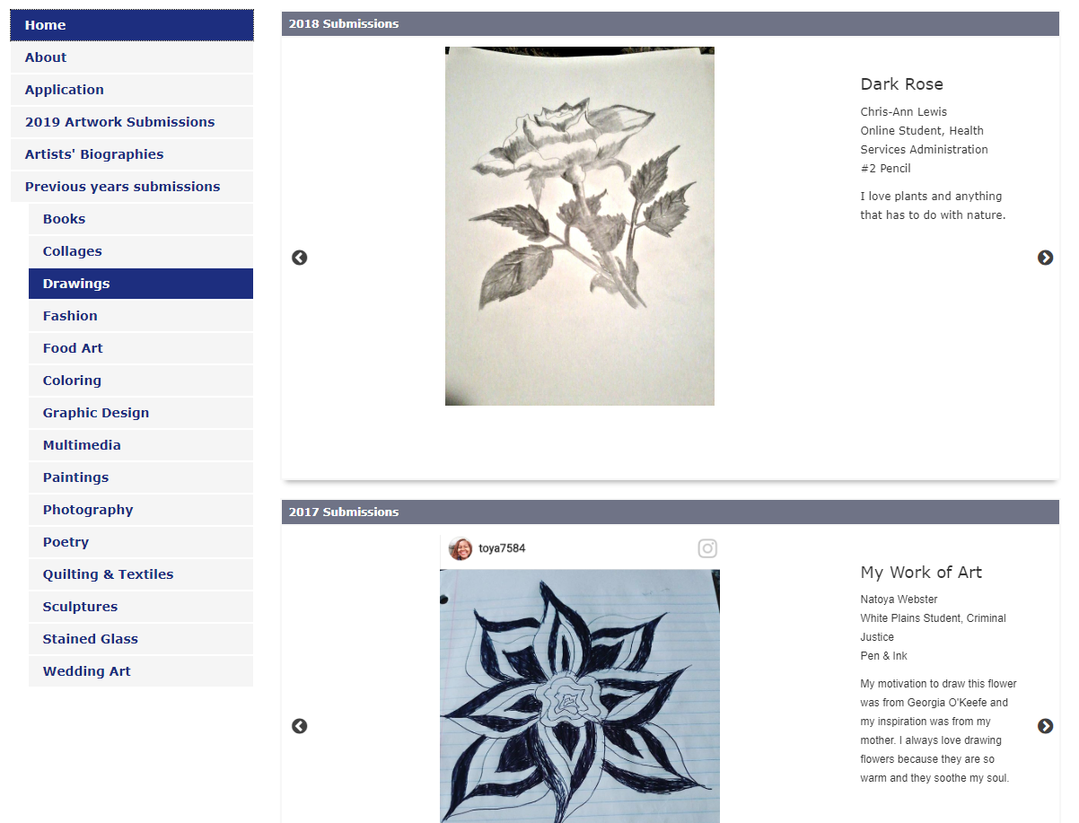
Arts & Creativity Festival

Slide 12
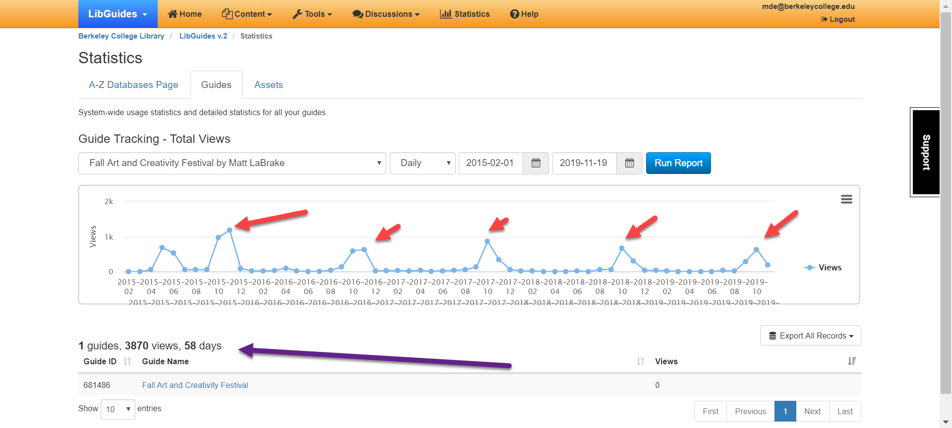
Usage Data

Slide 13
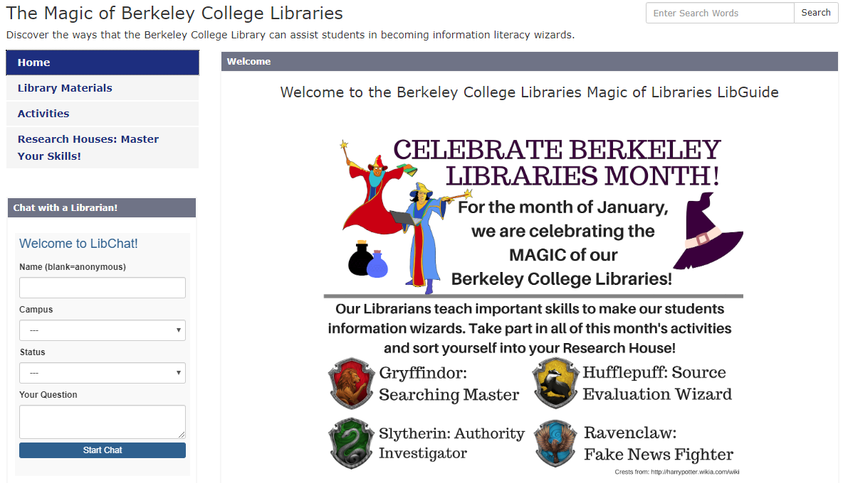
Celebrate Berkeley Libraries Month
https://berkeleycollege.libguides.com/c.php?g=896275&p=6446352​

Slide 14
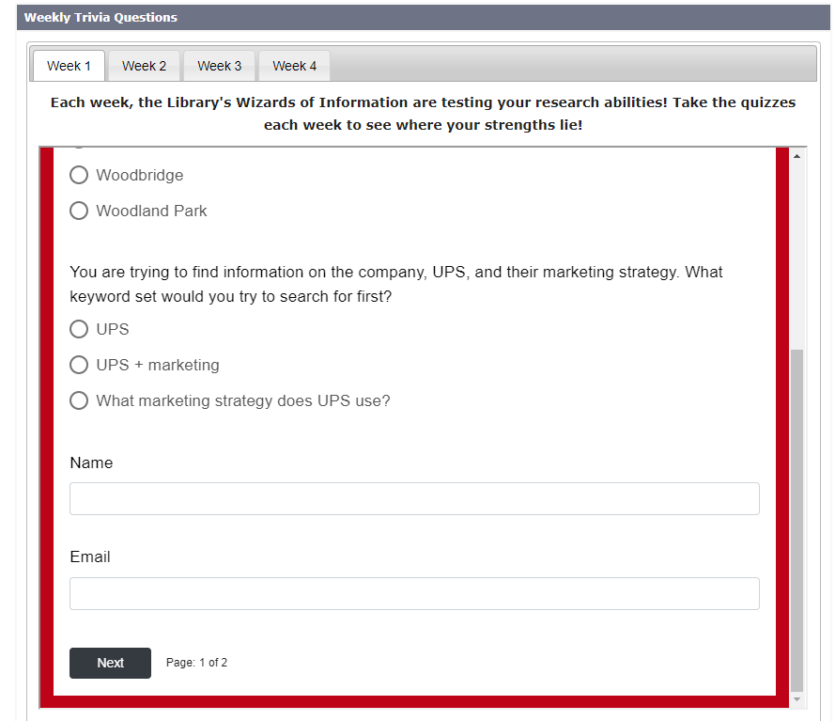
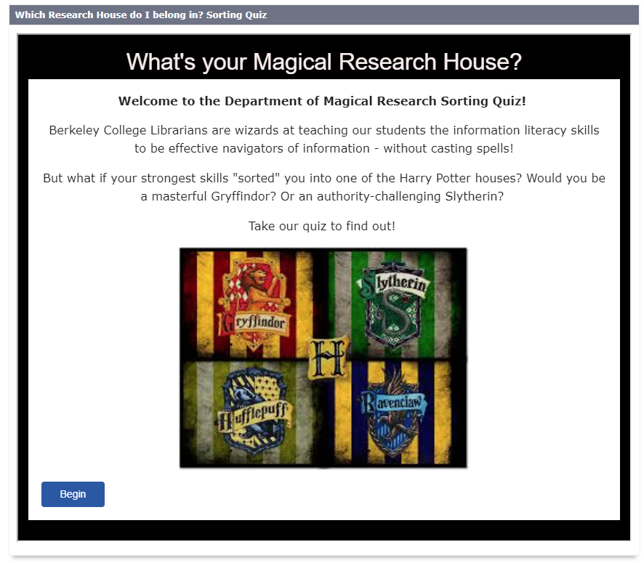
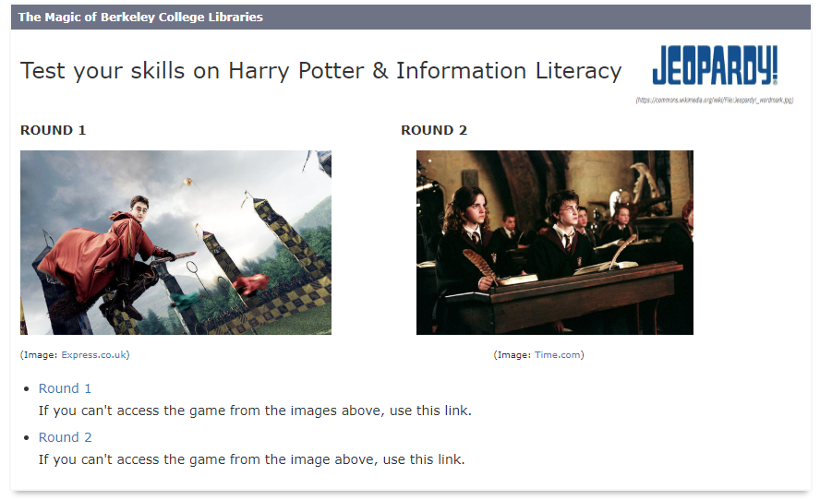

Slide 15

Promoting Resources & Services

Slide 16
Encouraging Participation
Building relationships with students through instruction/consultations
Faculty help in promoting resources and events
Sending email blasts
Partnering with Online Student Development to have programs included in their schedules/outreach
Making participation easy through embedded forms/activities
Offer incentives! (Free books for Online Book Club participation)

Slide 17
Promoting
LibChat
FAQs
Texting
LIBANSWERS

Slide 18

Flyer
App info
Canned Message on Chat
FLIPSTER

Slide 19
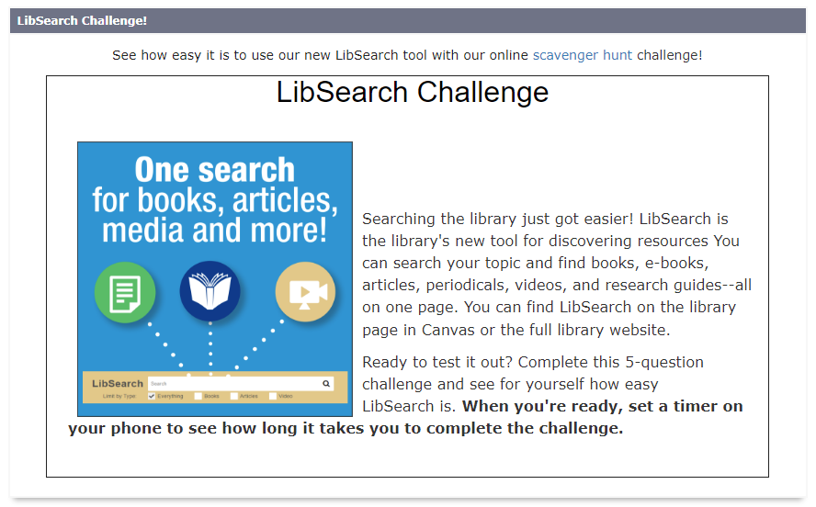
Flyer
Widgets
Search Game
LibWizard

Slide 20

Library Research Hour
Book Discussions
WHAT HAS NOT WORKED (YET)​
Synchronous Meetings​

