Slide 1

Streamlining Library Access for Online students
Stephen Walker, Head of Access Services, Lehman College/CUNY
November 21, 2019

Slide 2
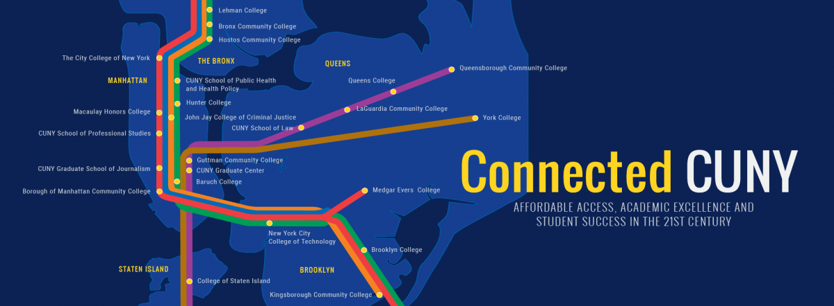
CUNY campus locations
24 campuses across 5 NYC boroughs
275,000 CUNY Students

Slide 3


CUNY’s Senior College in the Bronx
Over 15,000 students

Slide 4

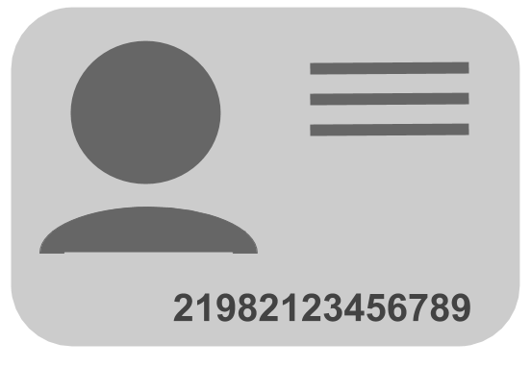
First Stage
Migrate EZproxy Server to CUNY Central
Change Login from LDAP to Barcode
Username:
Password:
Lehman
CUNY OLS
Dedicated Library Systems Manager
Global Updates
Streamline Aleph login for users
Barcodes are automatically loaded
Growing number of online students

Slide 5
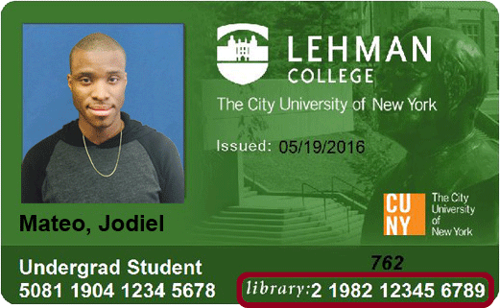
Lehman College ID card
Notes:
Should we keep this? It is funny

Slide 6
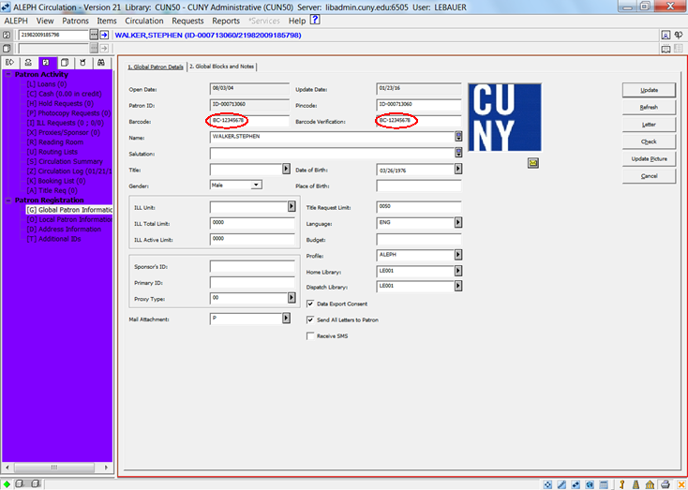
Account without Barcode
Notes:
Keep this

Slide 7
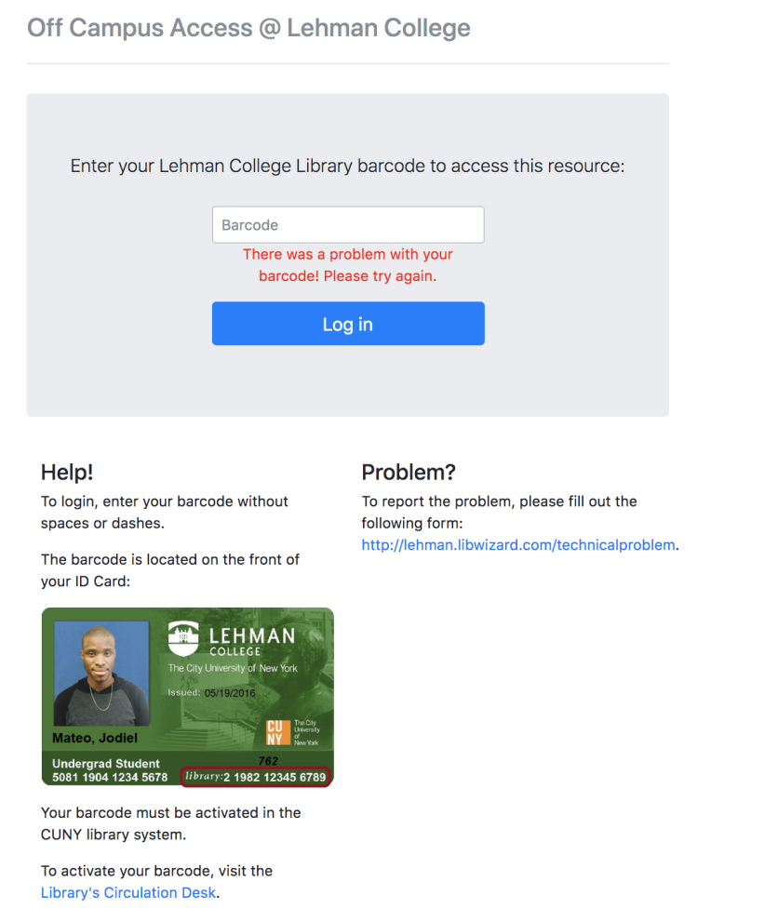
When an OFF-CAMPUS account DOESN’T WORK

Slide 8

Steps to generate a barcode #

Slide 9
COORDINATING BETWEEN DEPARTMENTS
Library
Office of Library Services (OLS)
Public
Safety
Office of Computing and Information Services (CIS)
Campus Data Center
and IT

Slide 10

How BarcodE automation OCCURS
Notes:
Change the graphic

Slide 11
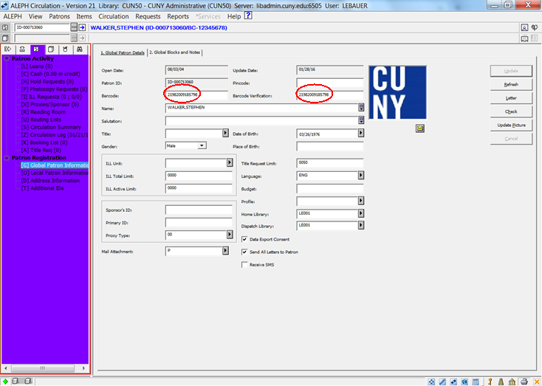
Account with Barcode

Slide 12
StrategIES for successful data load
Start with a small group of Patrons Freshman/Transfer students
Develop communication process for all stakeholders
Request list of all Patrons loaded
Notes:
Essential

Slide 13
Online student expansion
New Director of Online Education
Out Reach to Program Coordinators
Manual Creation of new Online Student Accounts
Notes:
Keep

Slide 14
Second Stage
Lehman College IT Department developed an App-- Lehman 360.
Library and Public Safety aided in the development of the Digital ID portion of the App.
Digital ID would present students with Library Barcode# for off campus access to databases.
Notes:
? Keep - Maybe

Slide 15
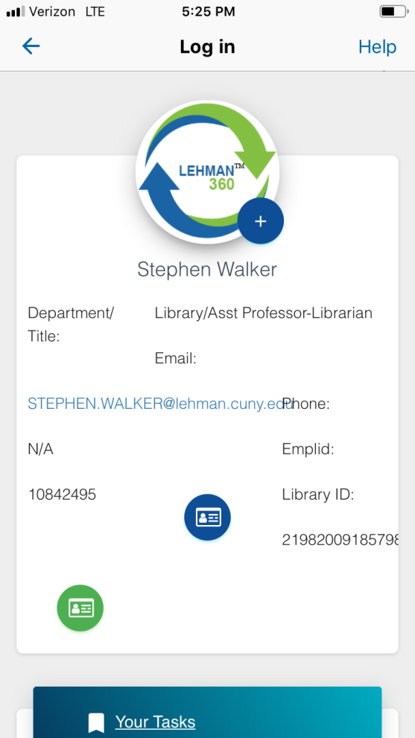
Lehman 360 app

Slide 16
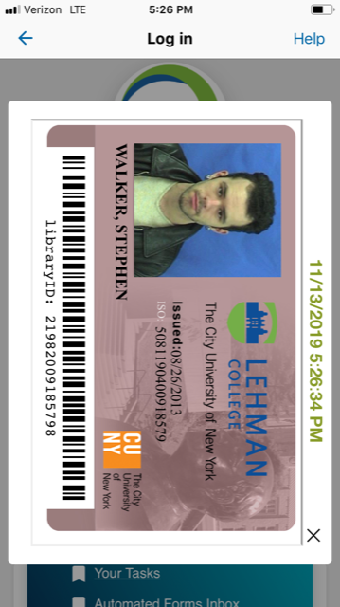
Lehman 360 Digital ID

Slide 17
Third Stage Libwizard trouble ticket

Slide 18
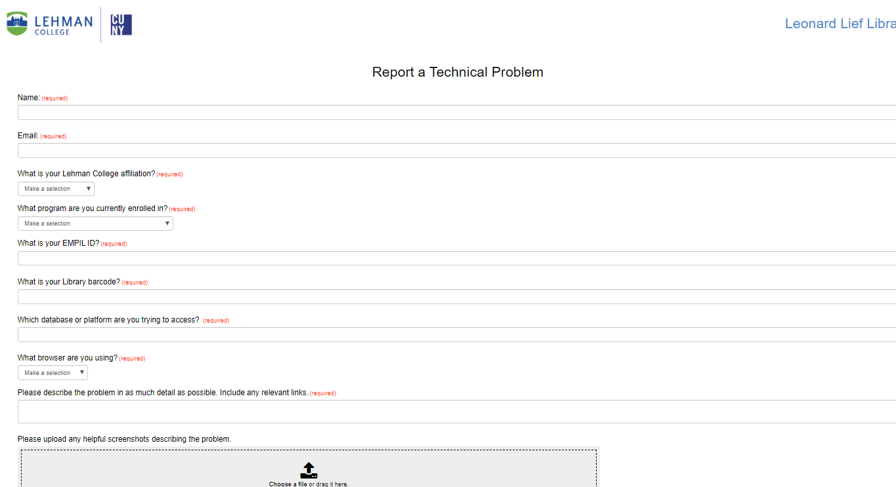
LibWizard Trouble ticket

Slide 19
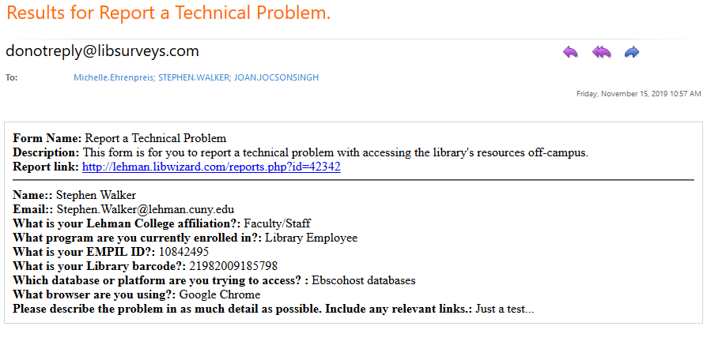
LibWizard Report

Slide 20
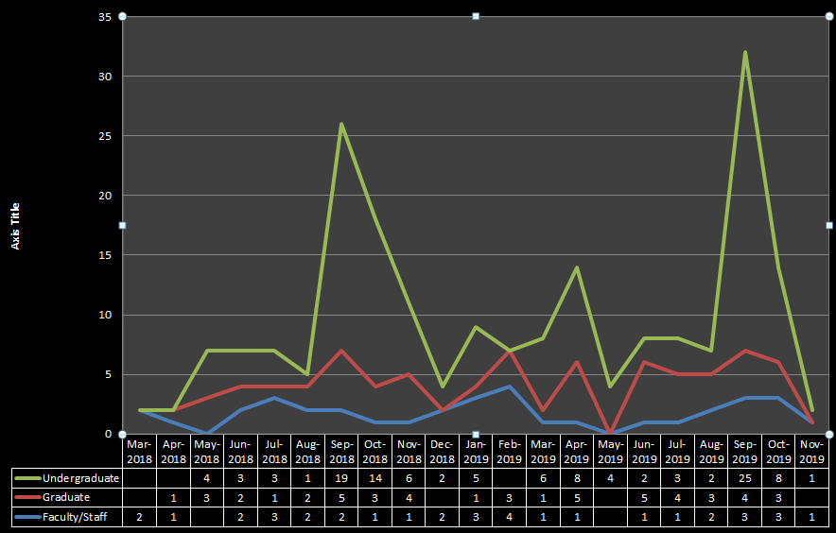
Data from Libwizard Trouble Ticket

Slide 21
Enrollment Data for Fall 2019
14,873 patrons loaded with barcode numbers and digital IDs created.
12,030 unique students (UG and GR) enrolled in one or more fully online, hybrid, or partially online courses.
611 unique fully online, hybrid, or partially online courses were offered.
1,962 unique course sections (UG and GR)
506 unique faculty taught in an online environment.
1267 faculty taught a course section of fully online, hybrid, or partially online course.

Slide 22
Online Education Programs
Online Masters of Arts in Health Education and Promotion.
Online Masters of Science in Business with a concentration in Human Resource Management.
Online Masters of Science of Organizational Leadership. (MSOL)
Online Bachelors of Science in Nursing. (RN to BS)
Online Gifted and Talented Certificate Extension
Online Health and Education Advanced Certificate

Slide 23
Thank You
Question???
Stephen.Walker@lehman.cuny.edu

