Slide 1

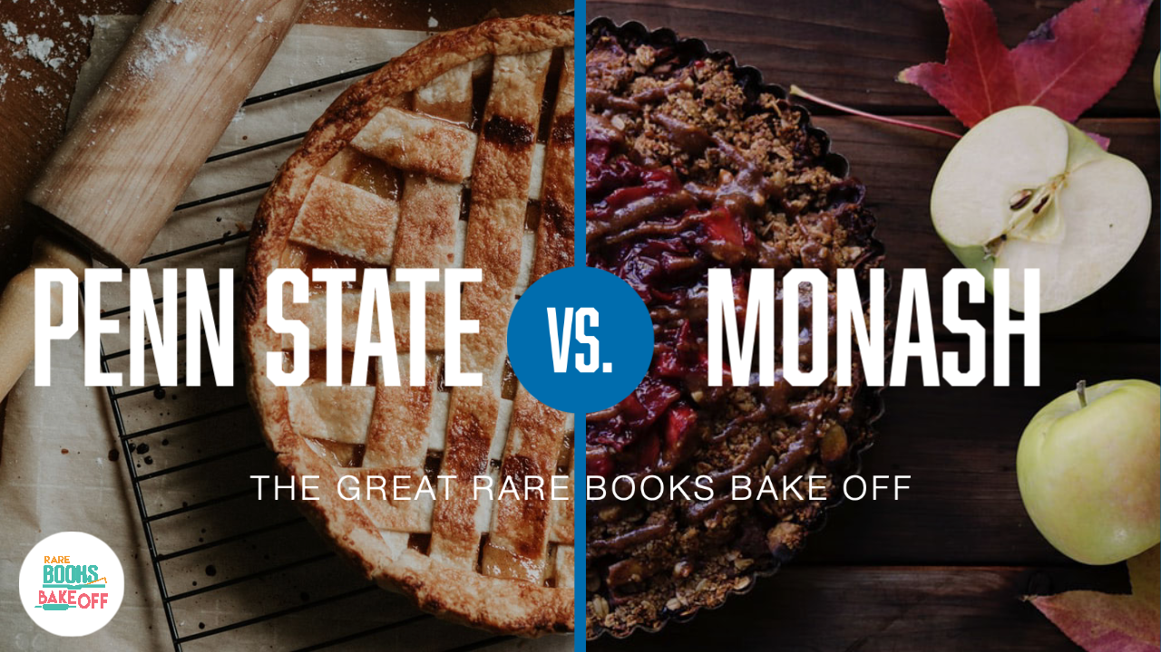
THE GREAT RARE BOOKS BAKE OFF

Slide 2

ABOUT THIS PRESENTATION
This presentation is an adaptation of our 2021 IFLA Marketing Award Ceremony Presentation.
Presentation Design by our Monash Colleague: Eliza Liddy
Mark Mattson
Head of Global Engagement Initiatives and International Partnerships Librarian
Penn State University
Christina Riehman-Murphy
Reference and Instruction Librarian
Penn State University

Slide 3
An International Academic Library Partnership
Partnership began in 2018 (PSU partnerships program began in 2016)
Based on the University’s strategic priorities
Flexible partnership models across our partnerships
  Knowledge and practice sharing​
  Joint data management infrastructure study​
  Joint workshop on library-based instruction​
  Bookbinding leather conservation project​
  No-fee interlibrary loan arrangements​
  Sharing professional development events and opportunities​
  Materials exchange​
  Joint research on librarian education and continuing development
  Staff and faculty exchange​

Slide 4
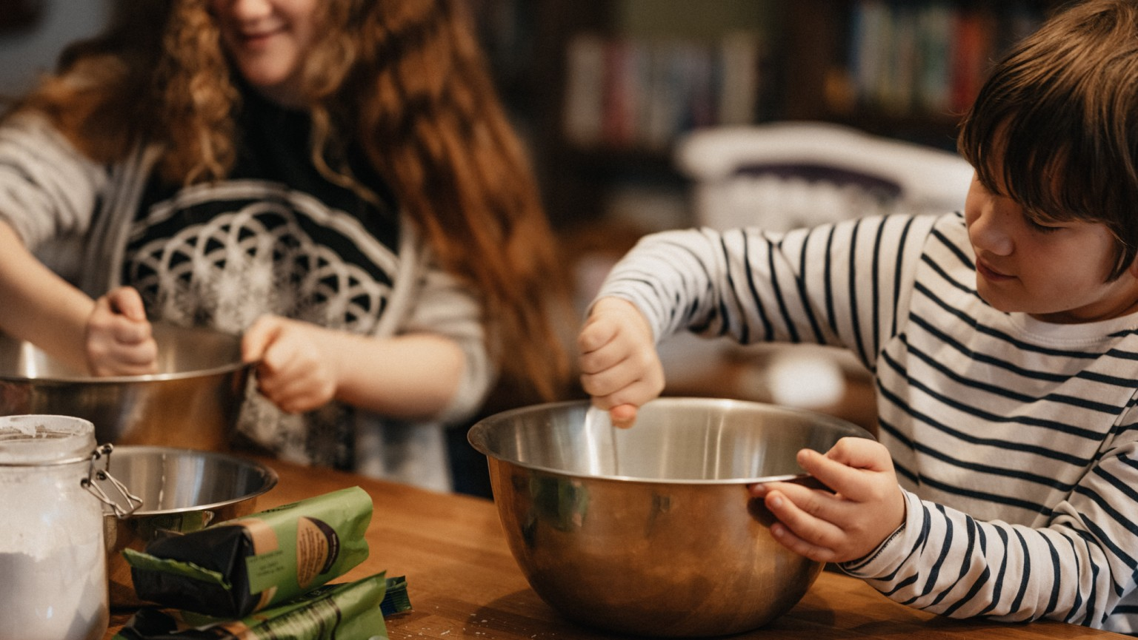
A FRIENDLY COMPETITION
BETWEEN MONASH UNIVERSITY LIBRARY AND THE PENN STATE UNIVERSITY LIBRARIES

Slide 5

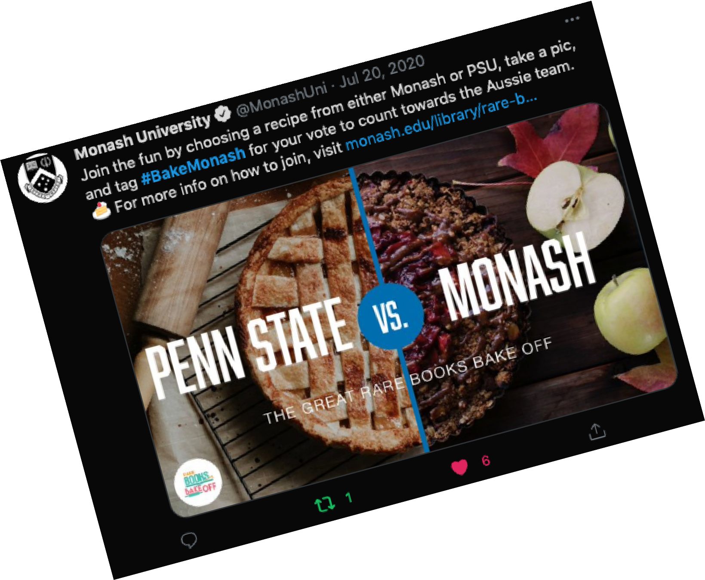
#BAKEMONASH VS. #BAKEPENNSTATE
The Libraries engaged their communities with their collections by inviting participants to bake featured recipes from rare materials found in their special collections and post the results to their social media using their university's entry hashtags (#BakeMonash and #BakePennState).

Slide 6

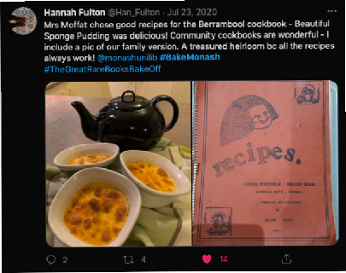
BENEFITS
01
02
03
PROMOTE
Promote both libraries’ special collections materials
HIGHLIGHT
Highlight the international partnership between the two libraries and their institutions
ENGAGE
Engage the two university communities with a relaxing diversion activity during a difficult time

Slide 7

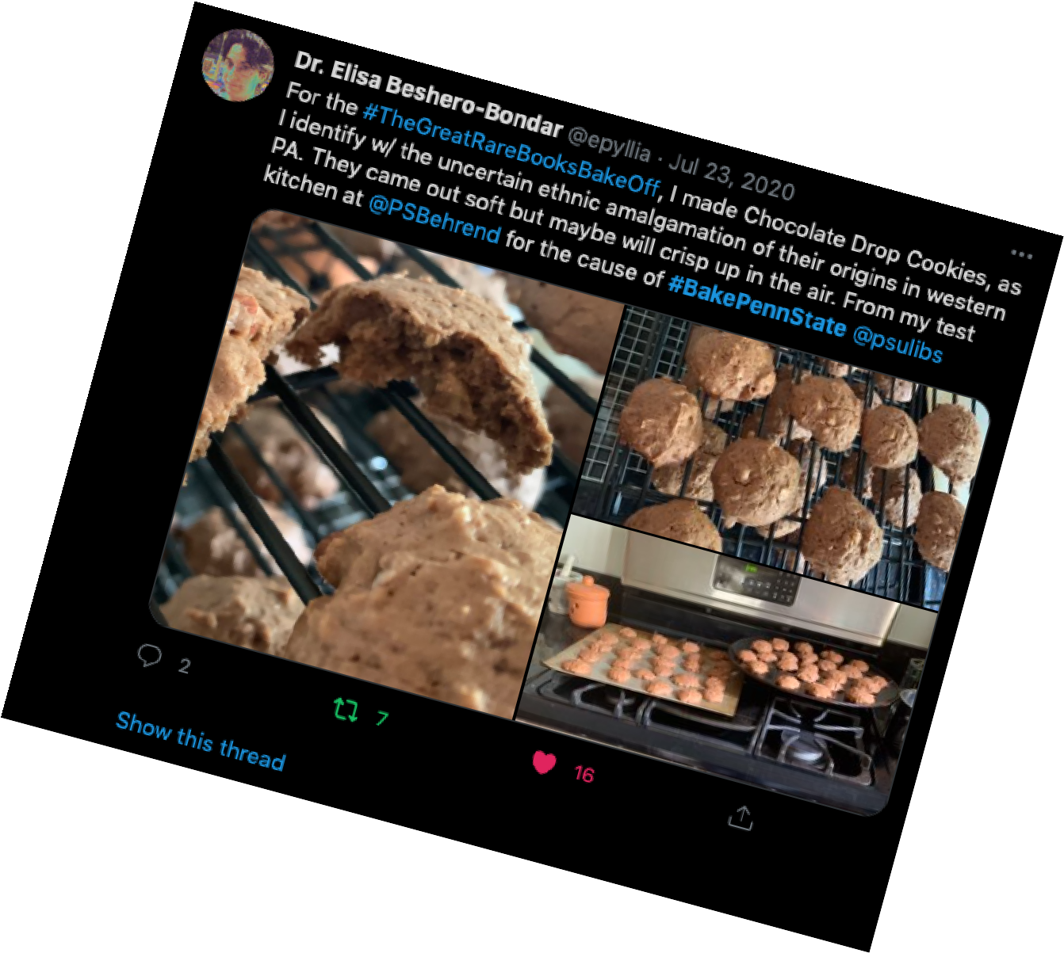
#BAKEMONASH VS. #BAKEPENNSTATE
Each social media post for their library earned the library one point (and increased visibility) with the library with the most points declared the winner of the contest. Tapping into a sense of community spirit, the project provided an enjoyable, creative, and culturally engaging outlet during the pandemic lockdowns while promoting the two libraries' international partnership, their respective collections, and the libraries as community institutions.

Slide 8

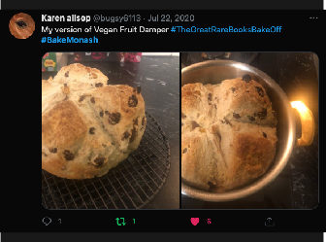
ENGAGEMENT
+53.3%
Total engagement increased by 53.3% on Monash University Library’s Facebook account as compared to the month before. This includes likes, clicks, comments, messages and shares.
+98.2%
Total engagement increased by 98.2% on Monash University Library’s Twitter account, compared to the month before. This includes likes, replies, messages and retweets.
+76%
Total engagement increased by 76% across Penn State Library’s Facebook, Twitter and Instagram accounts. This includes likes, replies, messages, reposts and retweets.

Slide 9
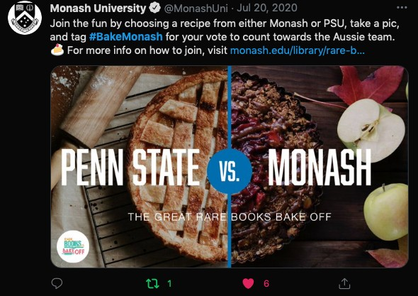
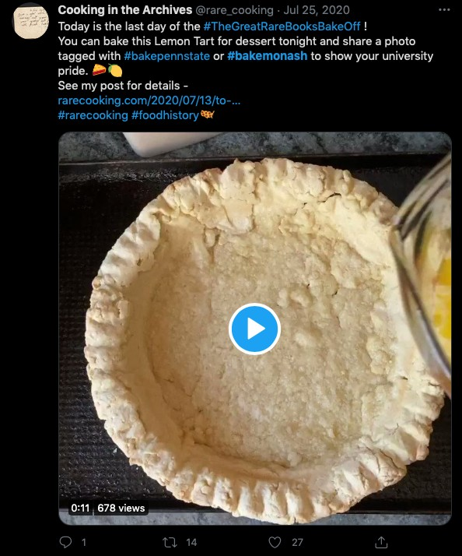
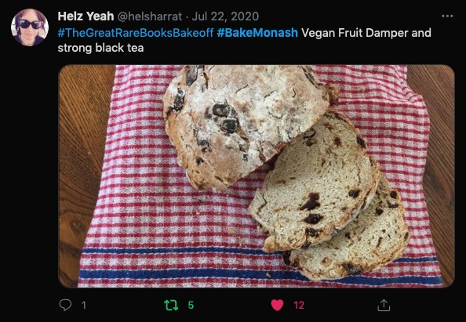
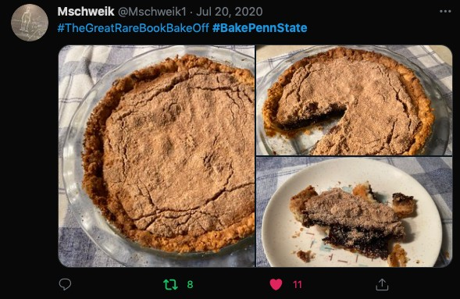
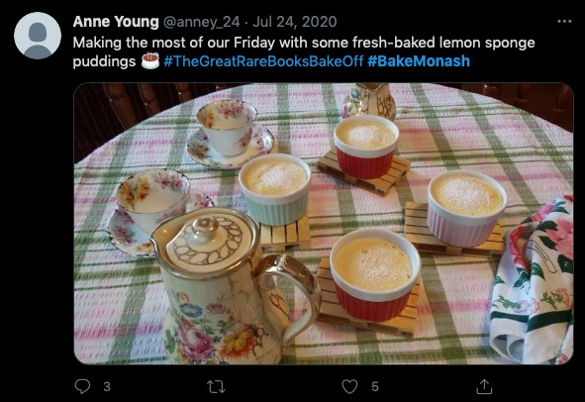
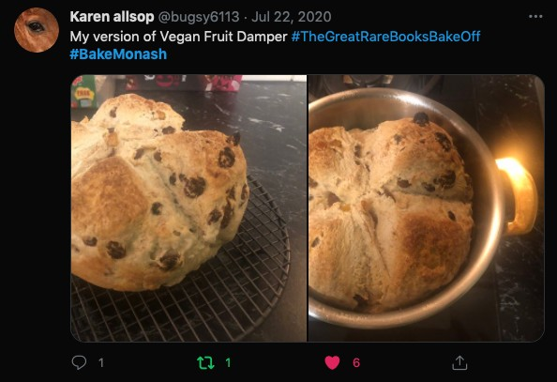
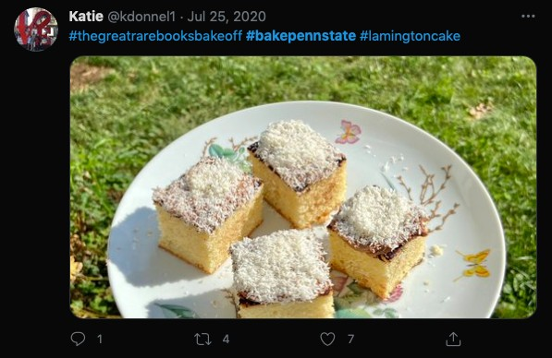
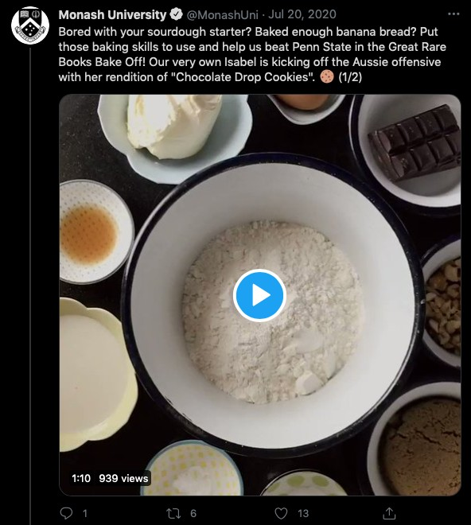
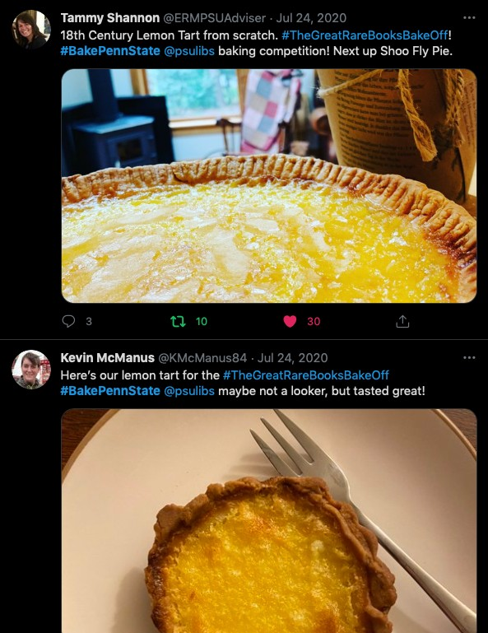
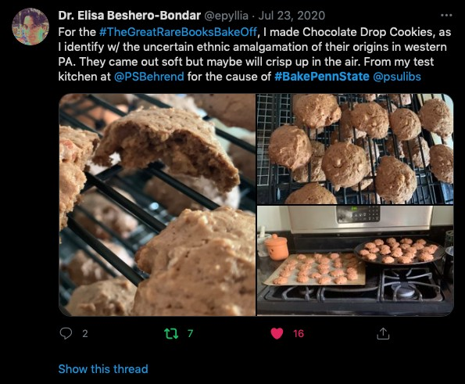
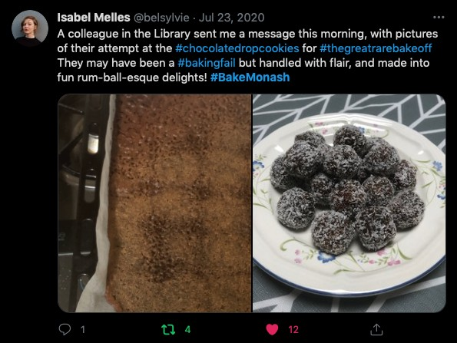
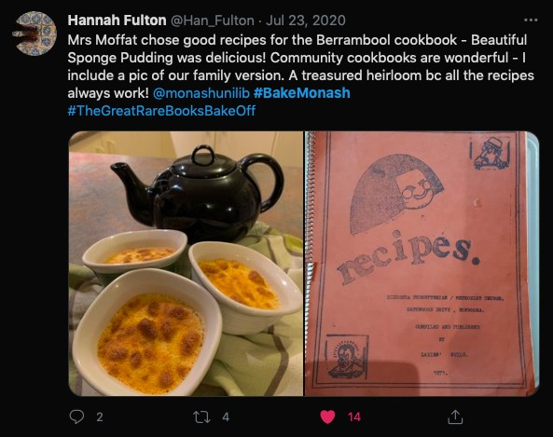

Slide 10
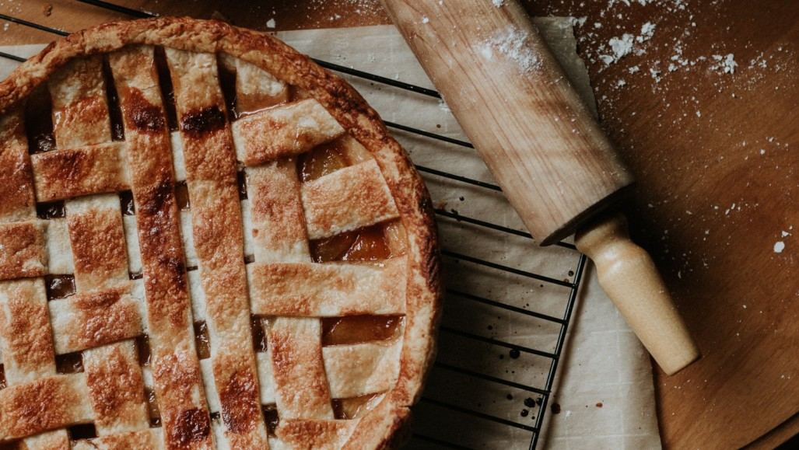
THANKS
Monash University Library &
Penn S tate University Library
Contact:
Mark Mattson mam1196@psu.edu
Christina Riehman-Murphy
cer20@psu.edu

