Slide 1
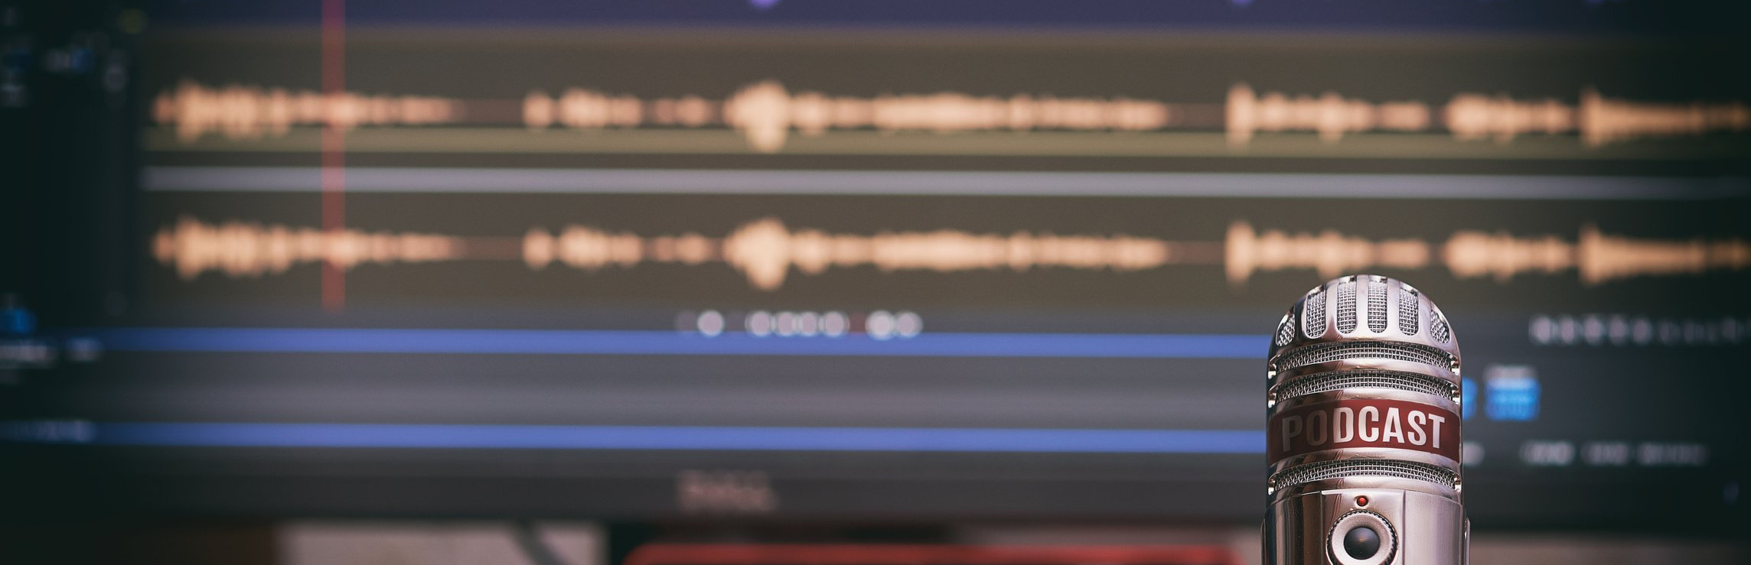
Don't Forget to Press Record
Adventures in Pandemic Podcasting
Amanda Tarbet, MLIS
Notes:
Hi, everyone. My name is Amanda Tarbet and I am delighted to be here to present Don't Forget to Press Record, Adventures in Pandemic Podcasting.

Slide 2
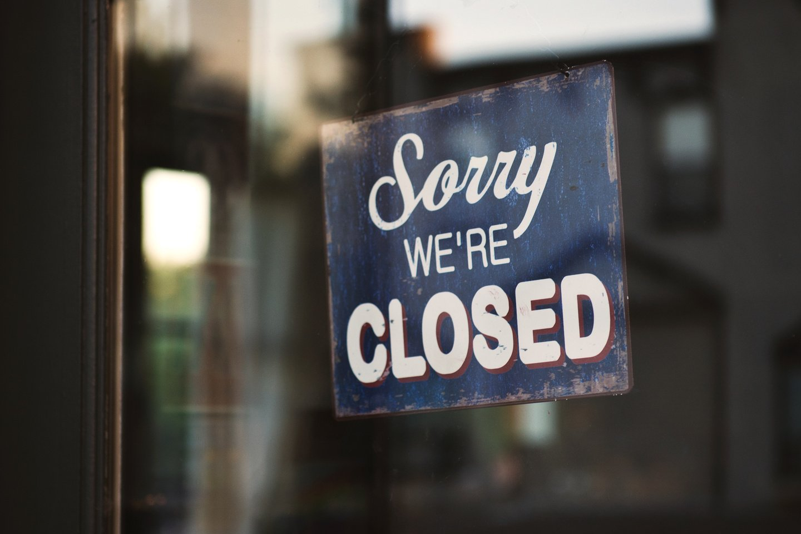
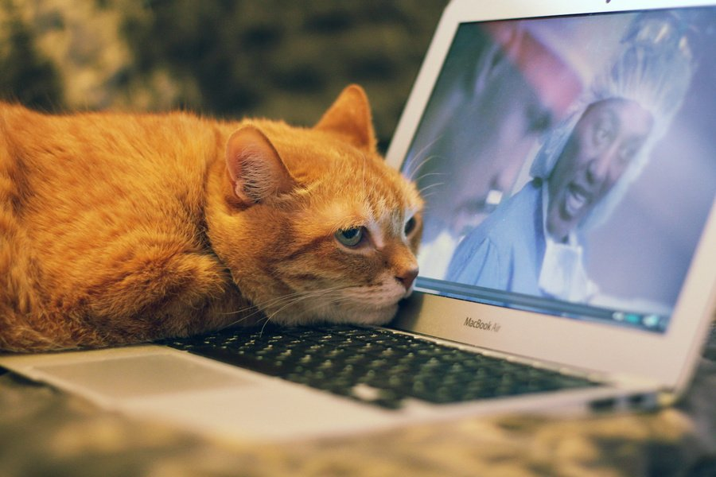
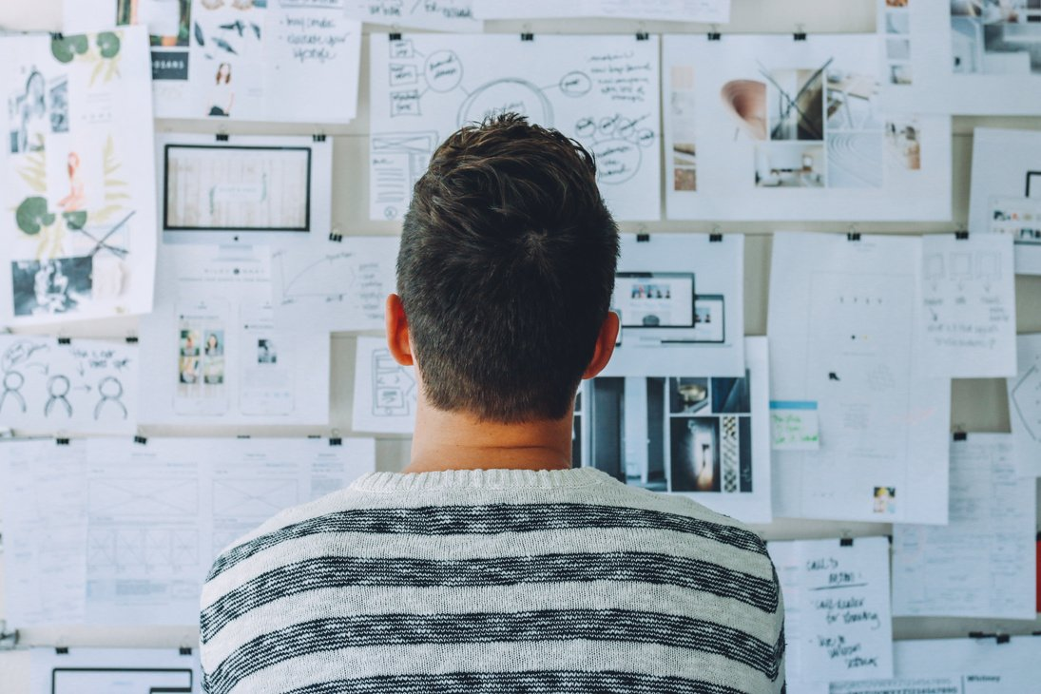
Three true things
MGH INSTITUTE OF HEALTH PROFESSIONS (MOSTLY) CLOSED
RAMPANT ZOOM FATIGUE
COOL STUDENT RESEARCH
Notes:
In the fall of 2020, three things were defintitely true. First, at my workplace, the MGH Institute of Health Professions--a small, independent health sciences graduate school in Boston, Massachusetts, hereafter known as the IHP--we still did not know when we would be returning to campus full time. The physical library was closed for everything except contactless pickup, and our website visits and Ask a Librarian submissions were down. In short, we were struggling to engage our community given the constraints we were under. Second, everyone in our community was Zoomed out. While we had had success with Zoom events in the spring and summer, enthusiasm for such events was waning, making meaningful outreach to our community difficult. And third, despite the pandemic constraints placed on them, many of our students were undertaking fascinating research projects for their capstone requirements.

Slide 3
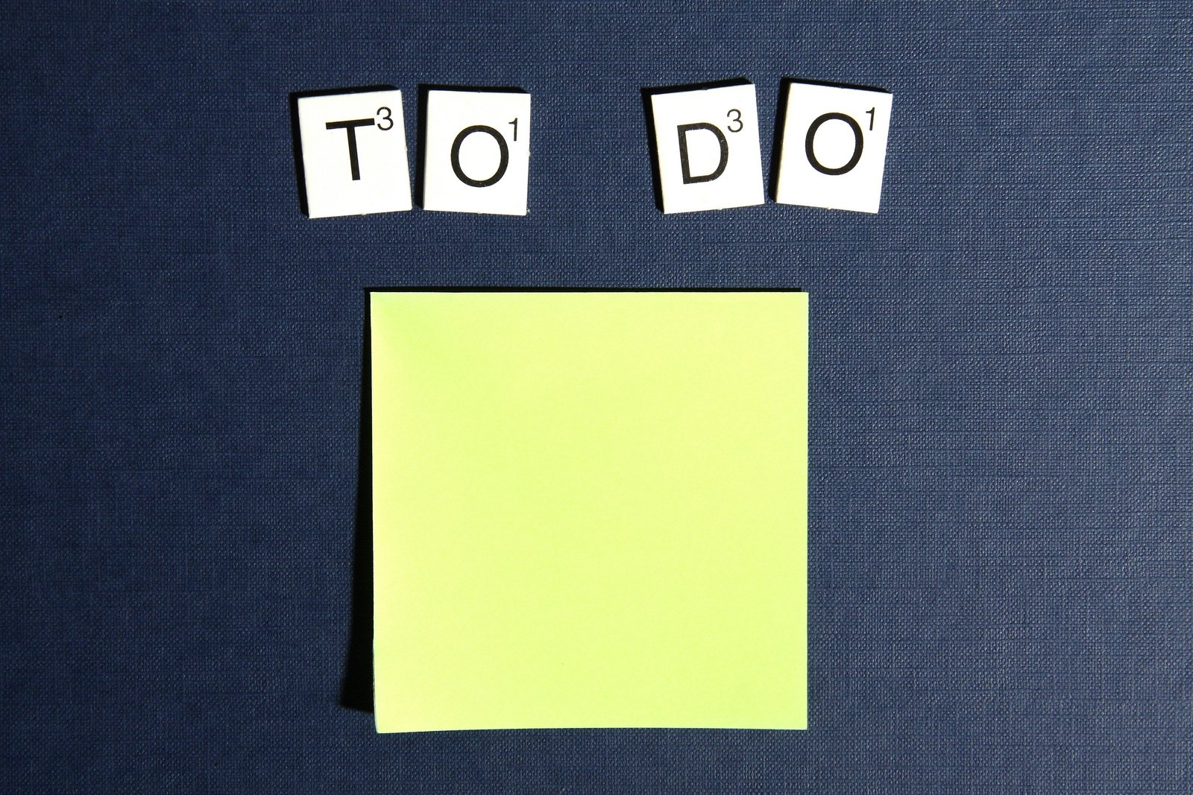
student
research
podcast?
Not the actual sticky note.
Notes:
The way our students seem to light up when discussing their capstone projects with me is one of my favorite things about being a librarian. I had, for a few years, kept a sticky note on my office wall that simply said "student research podcast?" question mark? A placeholder for a dream project of mine that I never seemed to have the time to think about for longer than a few minutes at once. I felt strongly that the stories behind student research happening at our institution needed to be told, but conditions were never right to attempt such an undertaking... until last year. I had some extra time on my hands and our library needed a novel way to engage our campus community that accommodated physical distancing and asynchronous lifestyles. Could a podcast help us achieve that? There was only one way to find out.

Slide 4
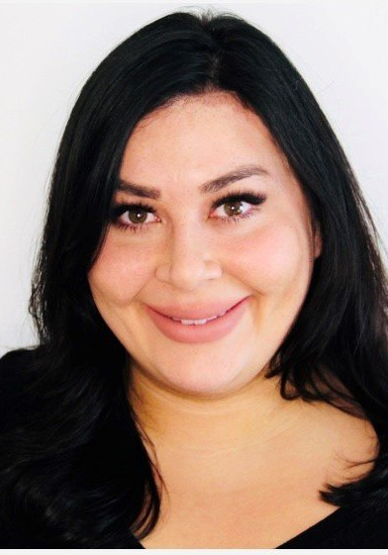
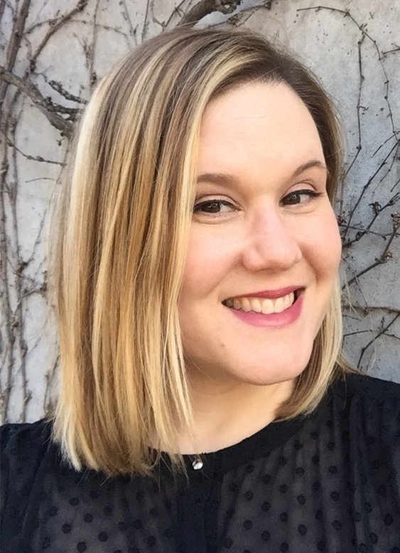
Teamwork makes the dream work
RACHEL NORTON
SELENA CRAIG
Co-Host in Crime
MS SLP
IHP Alum
Producer Extraordinaire
Assoc. Director of Digital Media @ IHP
Notes:
I reached out to the two people I knew I wanted to bring this idea to life with, and thankfully they both agreed on the spot. Selena Craig, IHP's Associate Director of Digital Media, and Rachel Norton, a Masters in Speech-Language Pathology student and one of my student workers, whom I knew liked to talk about research as much as I did. Rachel agreed to be my co-host and Selena our producer.

Slide 5
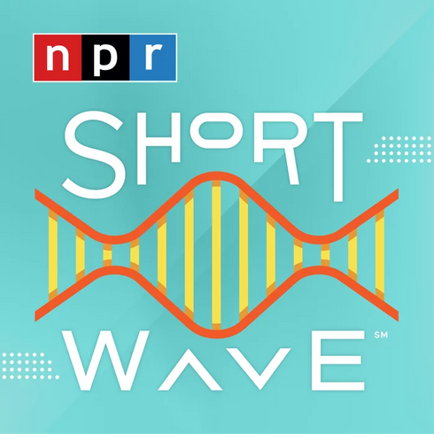
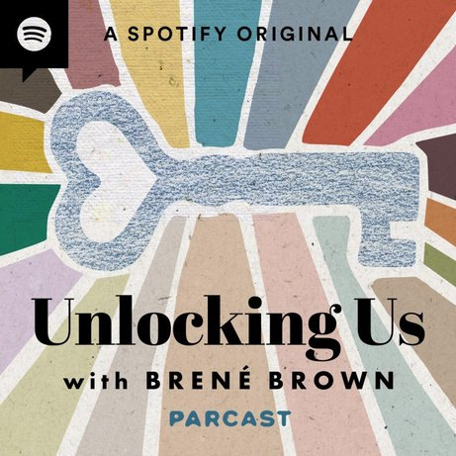
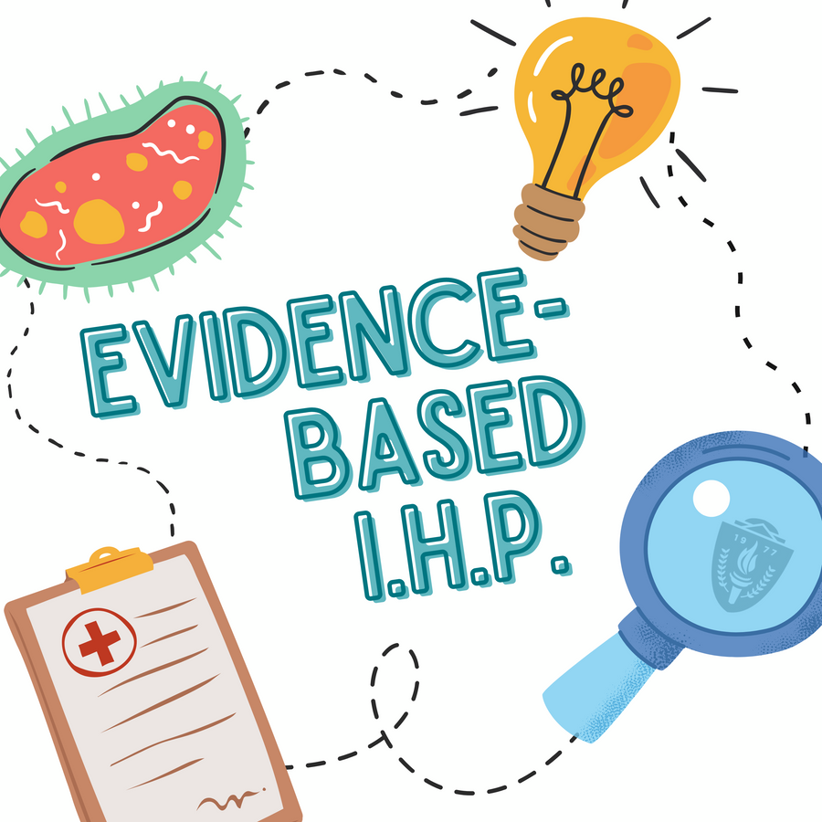
A podcast is born
+
=
Notes:
From our collaboration, Evidence-Based IHP was born, a podcast in which we interview a student or student team about their research project, exploring the study itself, as well as their experience working on their project. From what I was able to gather last fall, no other libraries or schools were doing a podcast like this at the time. As such, I took inspiration for our format from science podcasts like NPR's Shortwave and interview podcasts like Brené Brown's Unlocking Us.

Slide 6
Programs represented so far
01
PHYSICAL THERAPY POST-DOCTORAL FELLOWSHIP
03
MS IN NURSING
02
MS IN GENETIC COUNSELING
04
DOCTOR OF NURSING PRATICE
Notes:
Many of the students we interviewed were working on projects related to the pandemic in some way or had had their project upended by the pandemic. In the episodes we've published so far, we spoke with two physical therapy fellows about their research into the graduate school experiences of culturally and linguistically diverse learners, a genetic counseling student about her clinical research on Turner Syndrome, a masters of science in nursing student about her quality improvement study regarding pediatric allergies, and a doctor of nursing practice student about her qualitative investigation of hospital staff working in a Covid unit. Their studies were the launchpad to discuss topics like antiracism in research, the perils of peer review, health literacy and health communication and more. The guest in our upcoming episode is an occupational therapy doctoral student who interviewed practicing OTs about their pivot to telepractice at the start of the pandemic.
I will now talk about the resources we required, our workflow, the outcomes, and my major takeaways from this project so far.

Slide 7




Resources
Notes:
While my Director was on board with the project, there was no budget available to support it, so we had to do this as inexpensively as possible. Fortunately we were able to leverage some institutional resources to help allieviate costs. We had subscriptions to some applications through IHP's Office of Information Technology, which made them free for us. These include
Zoom to record remotely and save audio files for editing.
Microsoft Office, especially Teams to manage our project and communicate with each other.
Adobe Audition for audio editing.
And Transistor.fm for podcast hosting
We also used
Free YouTube tutorials and other internet resources to learn how to use Adobe Audition.
Creative Commons licensed songs for music.
$30 USB microphones that we purchased ourselves on Amazon.
And a significant time investment.
Thus, the total out-of-pocket financial cost was $90 for 3 mics. However, there was a high time investment, which you could argue is another type of cost. I did a rough calculation and each episode required an average of 20 hours of work from planning to recording, to editing, to promoting. That 20 hours does not include the time that went into planning the show, creating the logo and such, before we even recorded our first episode.
And because Rachel was still my student worker up until September of 2021, she was paid for the time that she put into the show, whereas Selena and I did 90% of our podcast work outside of normal working hours. We also had some help for things like fact checking from another of my student workers, Kimberly Ames, who has production assistant credit on some of the episodes. SO I did have some budget if you count all of the student worker hours spent.

Slide 8
Workflow
01
02
03
04
RECRUIT
PREPARE
RECORD
EDIT
05
06
07
08
APPROVE
PUBLISH
PROMOTE
REPEAT
Notes:
For each episode, we need to do the following tasks:
First, we identify a potential guest or guests and recruit them.
Once a guest is confirmed, we read the guest's work and prepare interview questions. To save time, we keep a question bank of questions that can be used with any guest. But there are always new questions specific to each guest. We send questions to our guests ahead of time to help them prepare, but some of our questions are thought of on the spot during the interview.
We schedule an interview time when the entire team and guest can be present. This is not always possible due to things like class and work schedules. For instance, Rachel had to miss one of our early episodes, so Selena filled in for her.
Then we record the interview on Zoom. Having a recording checklist reminding us to do things like Press Record, check mic levels, etc. was extremely helpful. We only had to restart an interview once, I believe, before we realized a checklist was a necessity.
Next, we edit the audio for length and clarity. This is the step that takes the longest. With early episodes, I was new at editing, but I've gotten much more efficient at it over time. Selena and Rachel now help with this, too.

Slide 9
Workflow
01
02
03
04
RECRUIT
PREPARE
RECORD
EDIT
05
06
07
08
APPROVE
PUBLISH
PROMOTE
REPEAT
Notes:
We also record additional audio such as intros and occasionally closing discussions based on content in the interview. This is typically just me and Rachel, or both of us and Selena. That additional audio also needs to be edited.
Once the episode is compiled, we send it to both our guest and their program chair for their approval. We haven't had any issues with seeking approval and one can argue that it's not totally necessary, but we felt it was important to this project being seen as collaborative. In fact, getting feedback from guests and program chairs improved the episodes.
When all the i's have been dotted and t's have been crossed, we publish the episode to Transistor, which includes writing the copy. We can then promote the episode on the library's social media, in the school's daily newsletter, on the school's social media, and by word of mouth.
Then we do it all over again. In reality, these steps are usually happening for multiple episodes simultaneously. We have actually recorded all of the interviews for season 1 except for 1, so steps 1 through 3 are done, and we are currently on a loop of steps 4 through 8 for the remaining episodes.

Slide 10

Outcomes
Notes:
Transistor has built in analytics that tell us each episode is averaging about 53 downloads. If you think of that as equivalent to attendees at say a library sponsored event, that is very high for us and definitely exceeded my expectations. Because again, we are a small school and I have never had anywhere close to 50 people come to a single library program. The show also has longevity. People are listening to episodes months later after they debut.
We are currently surveying our listeners to explore what impact the podcast has had on them and to figure out exactly who our audience is. We won't have results for that survey until sometime next year. We are especially curious if the podcast has been of interest to anyone outside of the IHP such as the wider healthcare community, prospective students, or others.

Slide 11
Major takeaways
01
WORKLOAD
03
SIDE HUSTLES CAN FALL BY THE WAYSIDE
02
COLLABORATION IS KEY
04
AIM FOR INCLUSIVITY
Notes:
Here are 4 my major takeaways from this project. First, the workload. We had no idea of the amount of work it would take. I expected it would be a lot, but I can confidently say that it has been so much more than I anticipated. I personally have loved every minute of it. It's been a super fun creative outlet for me. But if you're thinking about starting up a podcast, I would advise making sure that your heart is truly in it.
Technically, I could have done this alone. And at first, I thought I was going to, because I knew everyone's plates were full and I didn't want to add one more thing to their workload. But I'm really glad that I at least asked, because this would have been way less creative and daring and fun without a team to bounce ideas off of and joke around and help make decisions. I don't think I would have gotten very far without Selena and Rachel on my team.
Side hustles are more susceptible to falling by the wayside. Initially we wanted to publish one episode per month starting in April 2020. Due to unforeseen personal circumstances such as illness and institutional reorganizations, we have been unable to keep up with this schedule, and are now at about every other month.
Intentional inclusivity helped the show reach its full potential. In an effort to spotlight diverse voices and experiences, we intentionally sought out BIPOC and LGBTQ+ students to invite to be guests, as well as students whose projects touched upon diversity, equity and inclusion issues.

Slide 12

Notes:
Recently Rachel graduated (yay, Rachel!) and I left my position at IHP to join the team at Library and Information Resources Network, Inc., an academic library consortium. Literally the week after I submitted this lightning talk, I got my hire offer, so it is very recent and we are still figuring out what happens next with the show. We received approval to finish up season 1 even though Rachel and I have departed the IHP. After that, a Season 2 will depend on if someone else at IHP wants to take on the hosting duties. I do feel like we successfully did what we set out to do, so I'm hopeful we can work something out that can keep the show going.

Slide 13

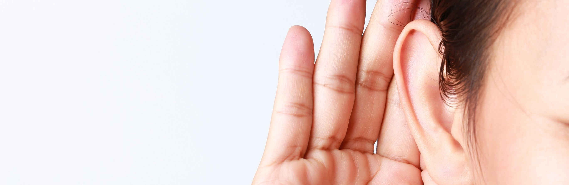
https://evidencebasedihp.transistor.fm/
amanda.tarbet@icloud.com @informologist
Notes:
Thank You all for listening. And thank you to Mark, Maria and Jessica for planning this event.
You can find Evidence-Based IHP at this URL or in your favorite podcast app.
If you have questions or want to talk podcasting, please email me or find me on Twitter. Thank you!

